Slide 1


24th Behavioural Modelling Summer School
Team
Indian Institute of Technology Bombay, India (IIT-B)
Day : 3
Date : 24 Sept, 2025

Slide 2
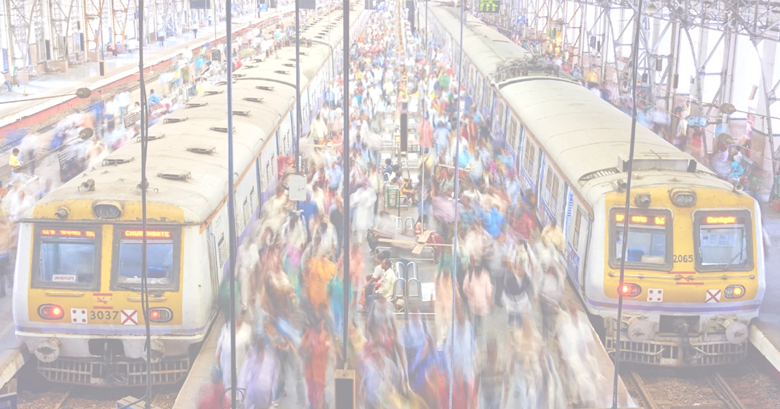
The Journey Matters: How Do Challenges to Walkability Affect Walking Experiences in Mumbai and Tokyo?

Slide 3
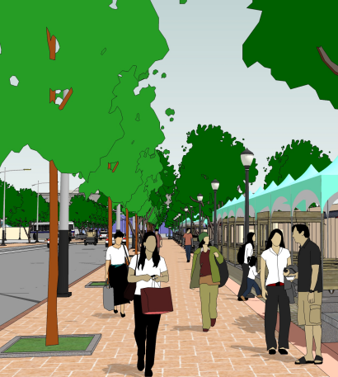
Introduction
Walkability - Ease and safety of walking in an area
Promotes health, sustainability, and livability
Key factor in modern urban planning
Influenced by sidewalks, safety, and connectivity
Boosts local economy and social interaction
Reduces traffic, pollution, and carbon footprint

Slide 4
Concept & Hypothesis
Weather Conditions
Socio- Demographic
Characteristic
Built Environment
Quality
Walking
Experience
Aesthetic
Safety
Purpose
Hypothesis 1 (H1): The built environment (including features like bench, sidewalks, crosswalks, greenery, streetlights, and storefronts) influences the overall walkability.
Hypothesis 2 (H2): An individual’s socio-economic and socio-demographic characteristics (age, gender) impact overall walkability.
Hypothesis 3 (H3): An individual’s trip purpose (mandatory, leisure) impact overall walkability.
Hypothesis 4 (H4): Rating of the urban scenery (beautiful, lively, wealthy, boring, depressing, safe) can affect walkability.

Slide 5
Why Mumbai and Tokyo?
Similarities |  | Dissimilarities
🌆 Both are mega cities & financial hubs |  | 🏙 Tokyo – planned, modern infra Mumbai – slums & informal economy
👥 Very high population density |  | 🚇 Tokyo – punctual, advanced transport Mumbai – overcrowded, developing metro
🚉 Public transport is lifeline |  | 💰 Tokyo – costly, high living standards Mumbai – Costly but high disparties

Slide 6
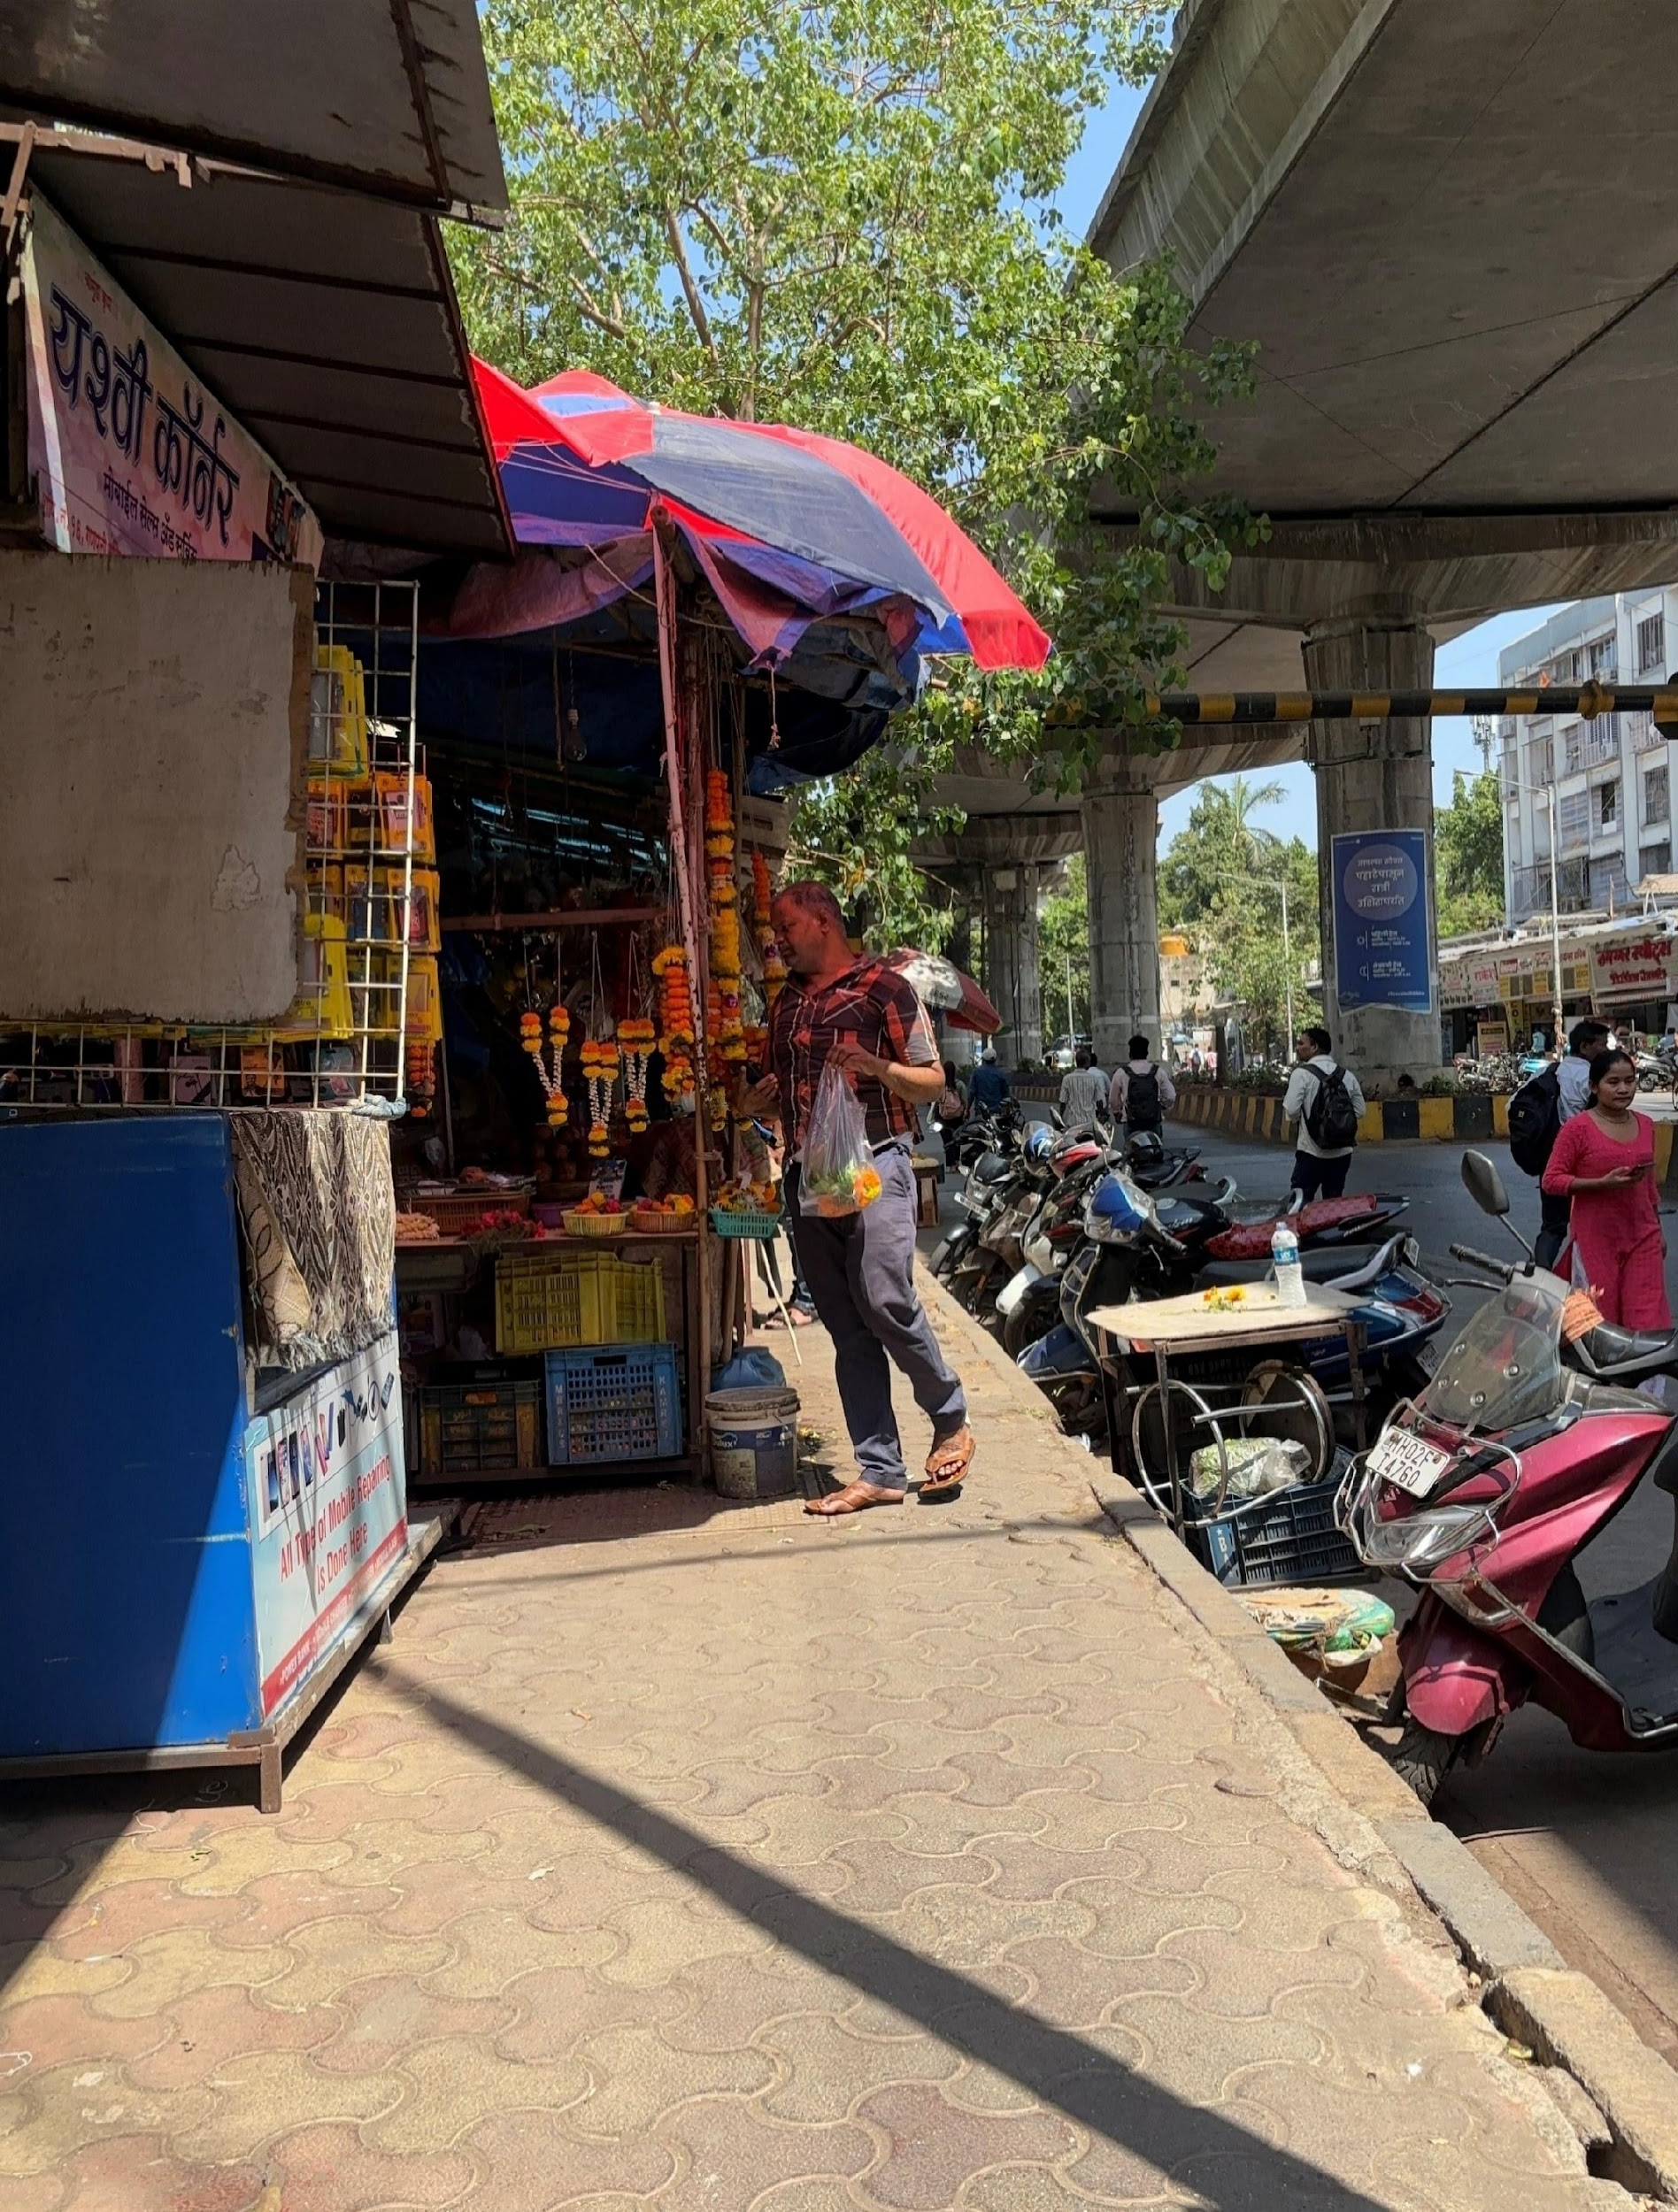
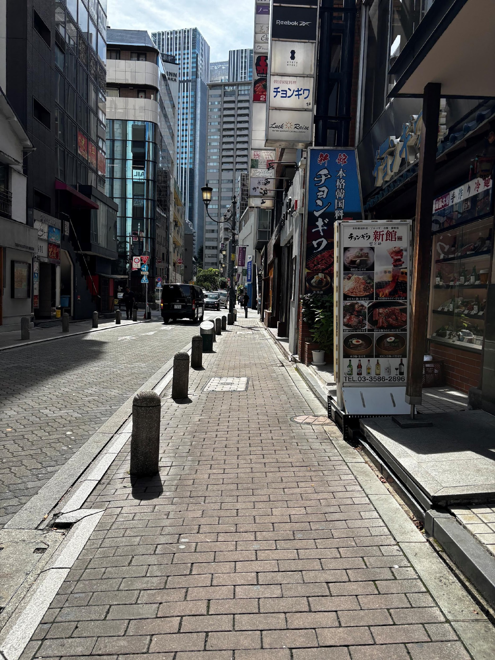
Objective & Comparison
Mumbai
Tokyo
Does walking behaviour vary with respect to walking infrastructure?
Uniform sidewalk but encroached
Uniformity across the sidewalk

Slide 7
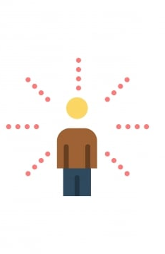




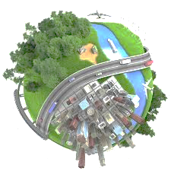


Data & Methodology
Mumbai
Tokyo
Used questionnaire-based survey.
Conducted near two major stations:
  Andheri(N=260)
  Ghatkopar(N=250)
Captured pedestrian perceptions of walking infrastructure:
Probe person data: Tokyo 2021
Global Street Scape Database¹
Socio- Demographic
Urban Perception Rating (1-10)
Beautiful', 'Boring', 'Depressing',
'Lively', 'Safe', 'Wealthy'
Trip Attributes
GPS Location
Segmentation (in %)
Building', ‘Green view’,
‘Sky view', Pedestrian area'
Map matching
Built Environment ( Yes/No)
Socio- Demographic
Trip Segment with Environmental Attributes
'Guard-Rail, 'Sidewalk’,
'Street-Light', 'Traffic-Sign'
Trip Attributes
Built Environment Rating
Safety Rating
Segment selected (N=172)
¹ Data Source: https://github.com/ualsg/global-streetscapes

Slide 8
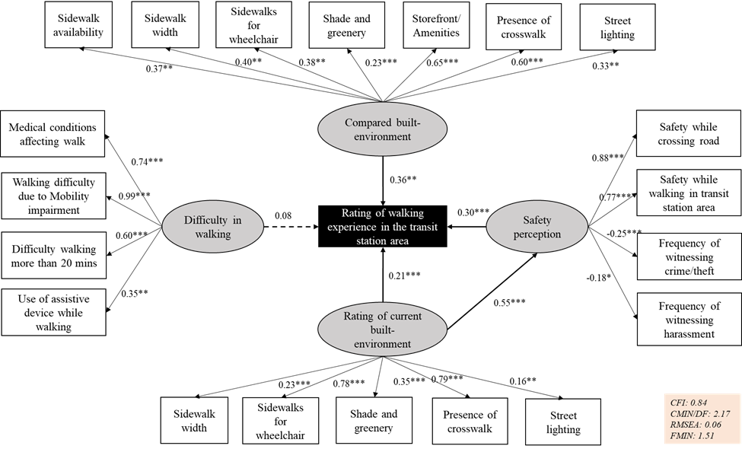

Results – Mumbai
Andheri
Ghatkopar
SEM Model
Better built environment (sidewalk width, lighting, greenery, crosswalks, storefronts) → stronger positive walking experience.
Safety matters most – Higher perception of safety (personal + traffic) strongly boosts walking experience
Sidewalk conditions considered more important in Ghatkopar
Presence of crosswalks considered more critical in Andheri

Slide 9
Results –Tokyo
Variable | Coefficient | Std. Error
Beautiful | 0.0909* | 0.047
Boring | 0.0612 | 0.052
Depressing | 0.0151 | 0.037
Lively | -0.1293*** | 0.038
Safe | -0.0552 | 0.039
Wealthy | 0.1453*** | 0.043
Building View | -0.7537 | 0.755
Green View | -0.6427 | 0.790
Sky View | 3.0942** | 1.294
Pedestrian Area | -1.5463** | 0.758
Guard-Rail | -0.0787 | 0.140
Sidewalk | 0.4458 | 0.327
Street-Light | 0.2215*** | 0.056
Traffic-Sign | 0.1951 | 0.197
Commuting to Work | 0.3377*** | 0.116
Other | 0.0506 | 0.108
Leisure | 0.0575 | 0.116
Age 0–39 | 0.0266 | 0.090
Age 40–49 | 0.0864 | 0.089
Age 50–59 | 0.1612* | 0.095
Age 60+ | 0.1717 | 0.108
Sex (Encoded) | 0.0851 | 0.061
Dependent variable: Walking speed
Algorithm | Relationship | RMSE | R² | MAE
Linear Regression | Linear | 0.07 | 0.31 | 0.19
Machine Learning Algorithm | Relationship | RMSE | R² | MAE
Random Forest | Non-linear | 0.05 | 0.55 | 0.16
X-GBoost | Non-linear | 0.05 | 0.53 | 0.17
CatBoost | Non-linear | 0.04 | 0.62 | 0.15
LightGBM | Non-linear | 0.04 | 0.60 | 0.16
Voting regressor | Non-linear | 0.045 | 0.59 | 0.16

Slide 10
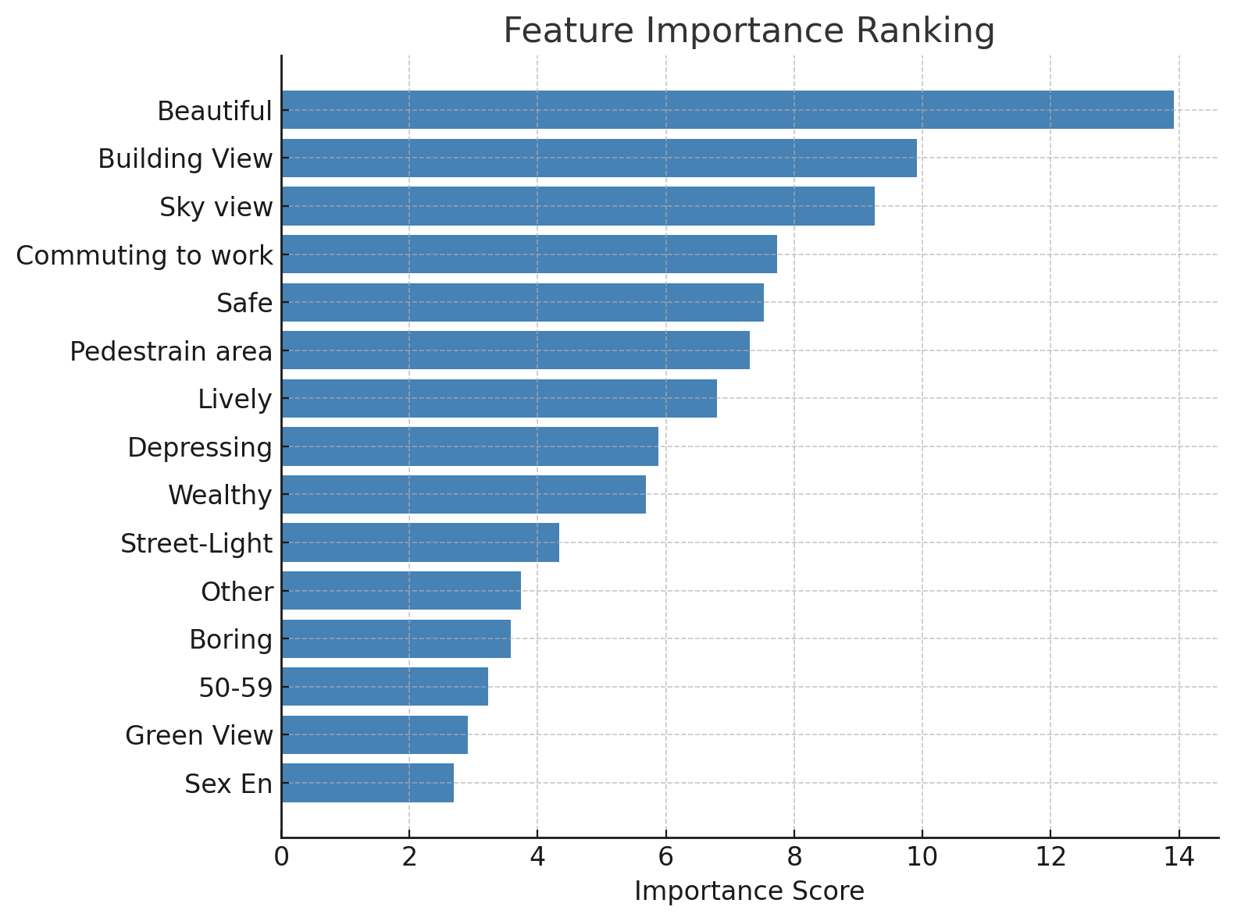
Results –Tokyo
Most Influential Factor : Environmental aesthetics & openness (Beautiful, Sky View, Building View) and Trip purpose ( Commuting to work) significantly increases walking pace.
Safety & infrastructure → Street-lighting strongly boosts walking speed.
Slowing factors: Lively (crowded, vibrant areas) and Pedestrian areas reduce walking pace.
Demographics: Middle-aged group (50–59) shows slightly higher walking speed; other age/sex differences are weak.

Slide 11
Conclusion and Policy Implication
Walking experience is shaped by safety, built environment quality, and aesthetics.
Mumbai |  | Tokyo
Strongest drivers: sidewalk quality, crosswalk presence, and safety. |  | Strongest drivers: environmental aesthetics (beauty, sky view, building view) and trip purpose (commuting).
Focus on basic infrastructure gaps (narrow/encroached sidewalks, poor lighting). |  | Street-lighting boosts speed, but crowded pedestrian areas slow pace
Walking experience often improved in transit catchments compared to residential neighborhoods. |  | More emphasis on aesthetic and experiential quality than basic access.
One size does not fit all despite similarities
Strengthen walkability by addressing Mumbai’s basic infrastructure gaps and enhancing Tokyo’s aesthetics, openness,

Slide 12
Thank you

