Slide 1

Dynamic Discrete Choice Model for Tohoku Residential Decision
Hiroshima University – Team B
Alolabi Reem
Azis Hakim S.
Azwan Nazamuddin
Hafiyyan Hilmy Fawwaz
Pujie Ma
HIROSHIMA UNIVERSITY

Slide 2
Table of contents
01
02
03
04
Motivation
Data
Model
Result

Slide 3
01
Motivation

Slide 4
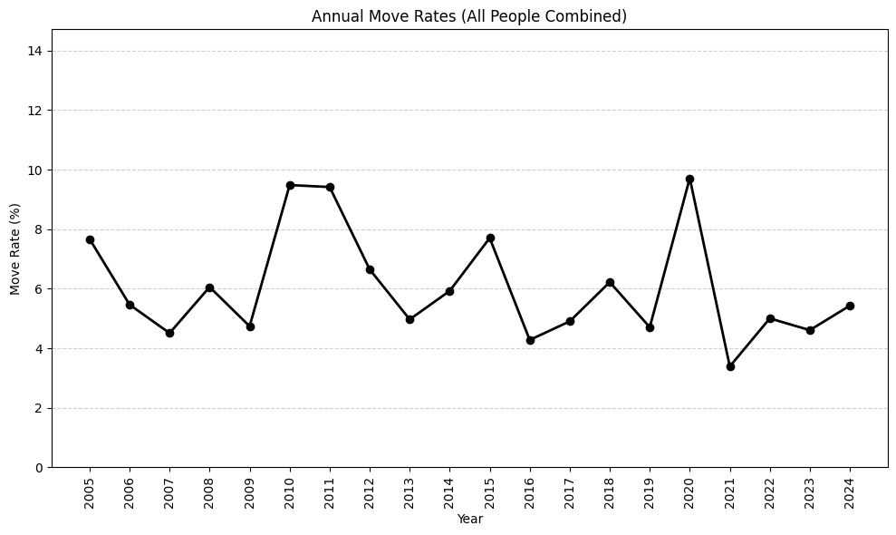
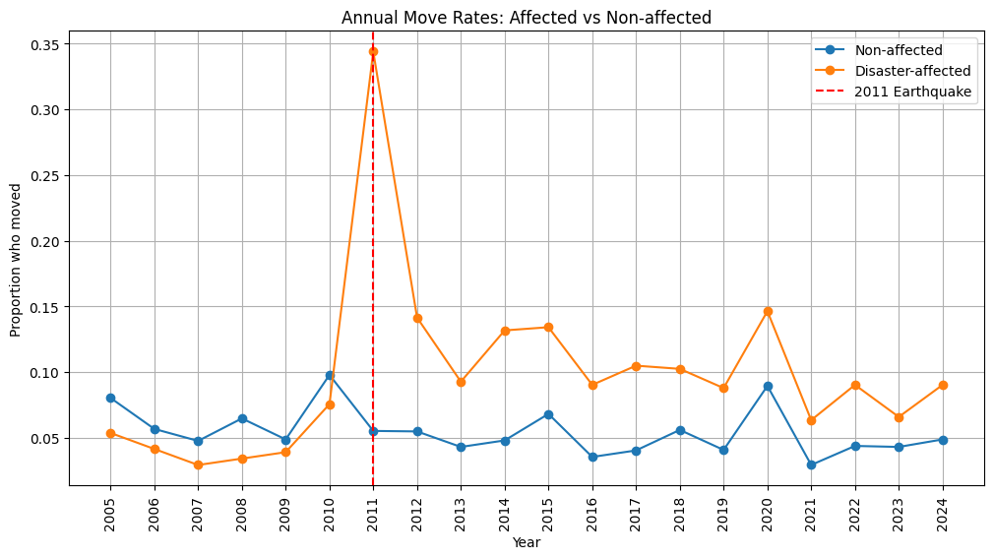
The main reason
Annual Move Rates of People Moving
This data is interesting because move rates overall is peaked in 2020, BUT…
When the data separated into affected and non-affected group 🡪 the affected group reached the highest move rates in 2011!
*Please note that we also have overall peak for move rates in 2020.

Slide 5
So, our objectives
Estimating how the 2011 Great East Japan Earthquake shifted people’s residential behavior.

Slide 6
How to Model Residential Behavior?
Dynamic Discreate Choice Model (DDCM)
Dynamic nature: Residential decision have long-term consequences
State dependence: Current location affects future utility
Life events: Marriage, birth, disaster create transition triggers
Forward-looking: Individual consider future opportunities
Natural Experiment: 2011 Great East Japan Earthquake
Exogenous shock to residential preferences
Clear before/after comparison
Evacuation 🡪 Recovery 🡪 New Equilibrium Patterns

Slide 7
02
Data

Slide 8
Before we dive too deep, lets see the data
Data Characteristic
Time span: 2005-2024 (20 years)
Data: (Tohoku_History Data)
df_history.csv: Individual yearly decisions (60,742 observations)
df_stay_var.csv: Current location characteristics (52,542 observations)
df_ex_var.csv: All destination attractiveness measures (525,402 observations)
initial_information.csv: Individual demographics (3,037 individuals)

Slide 9
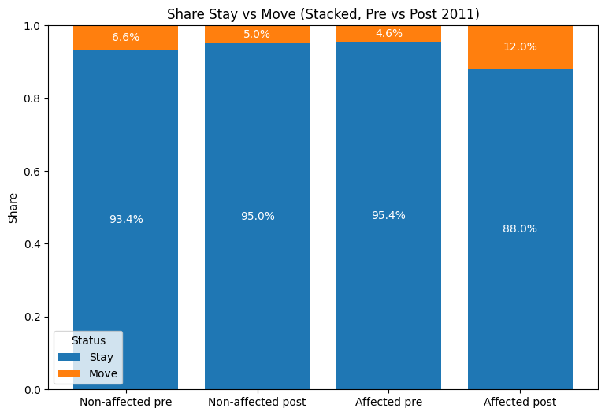
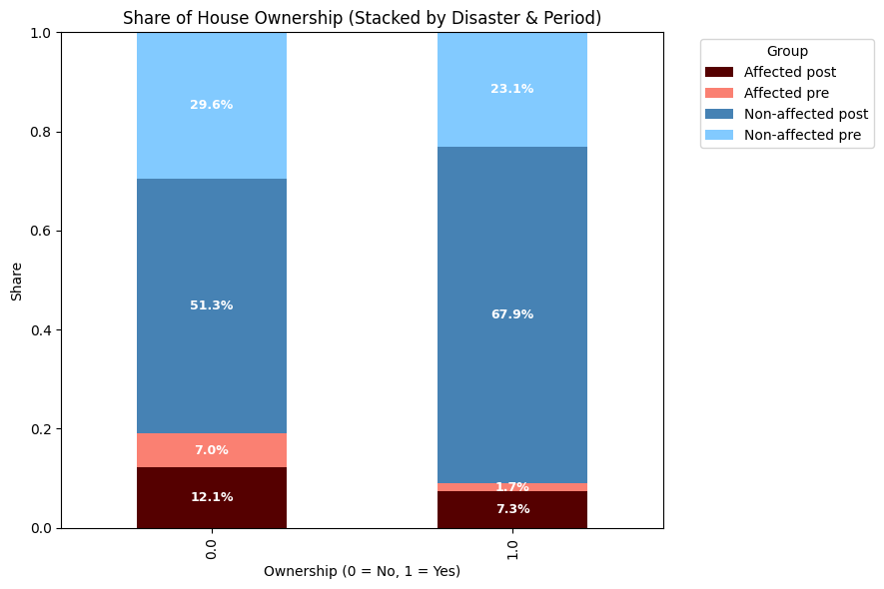
Before we dive too deep, lets see the data
The proportion of the moving residential for affected people after the disaster is increased than before!
And as you can see, the ownership of the house is BIG difference in share between disaster-affected and non-affected people.

Slide 10
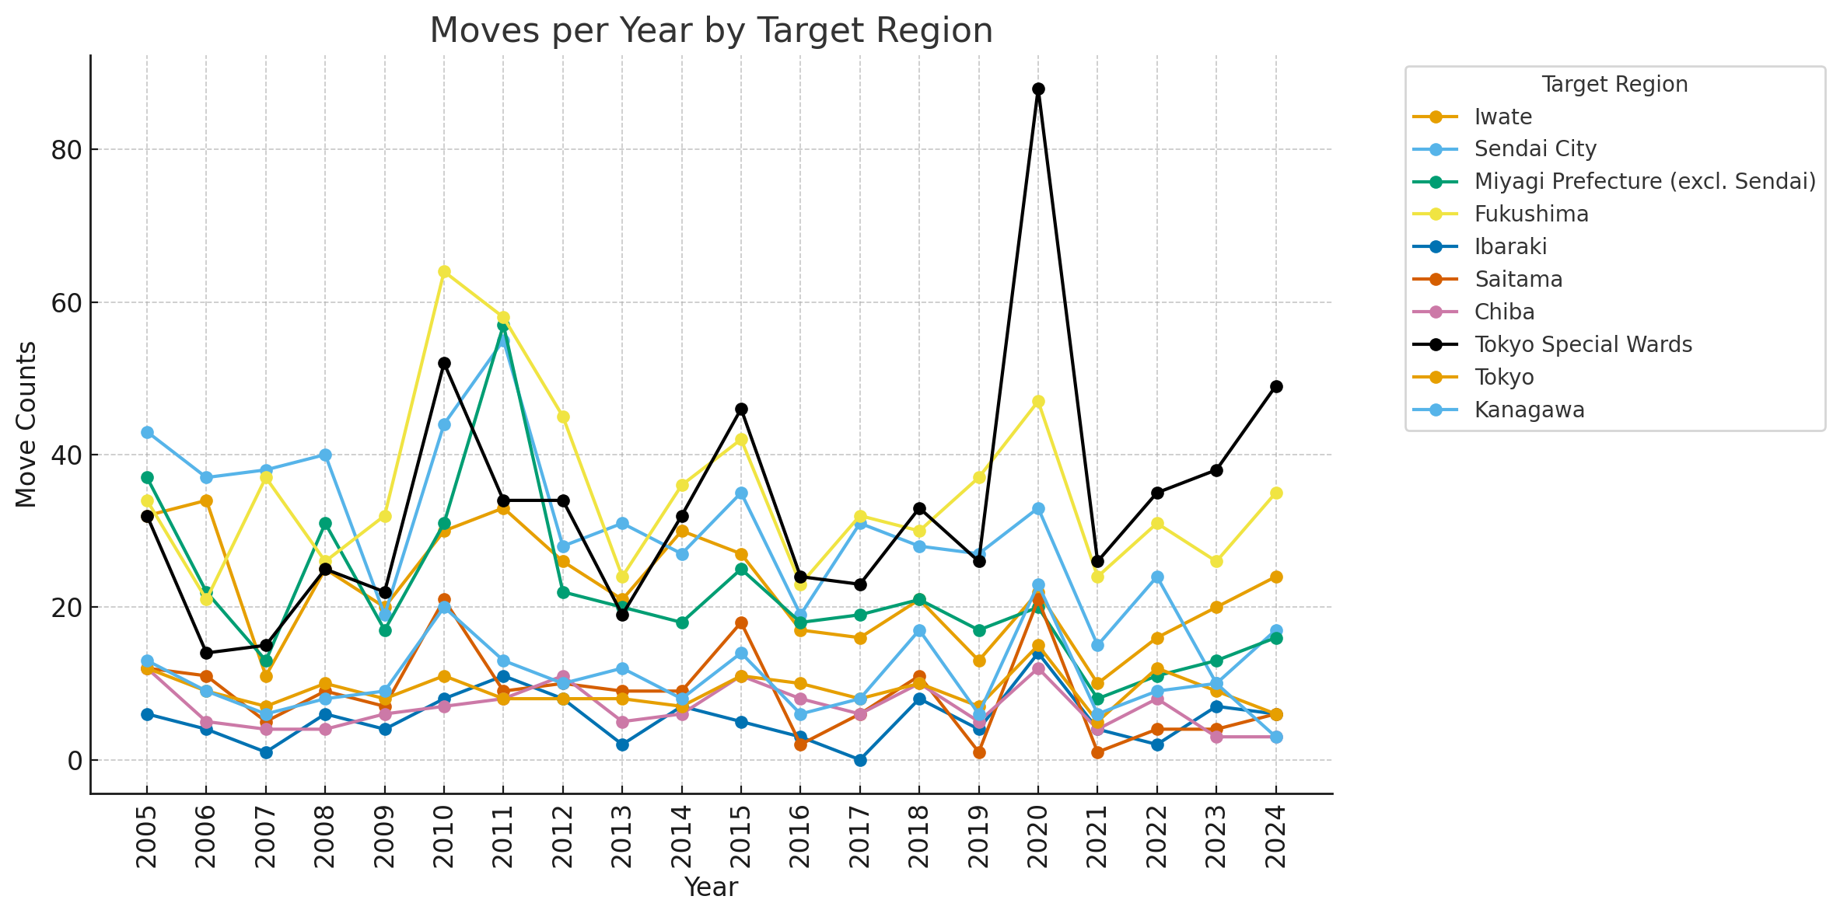
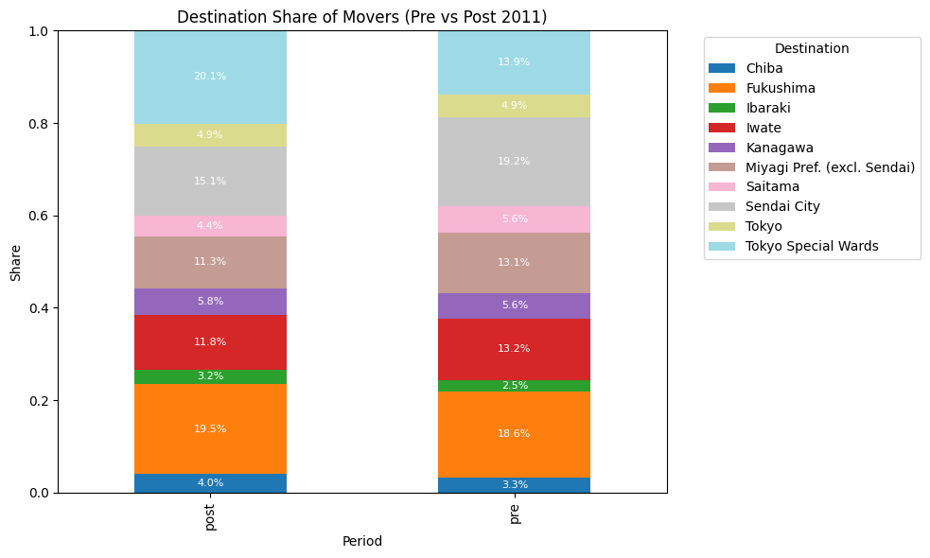
Before we dive too deep, lets see the data
The most of destination share of movers is Tokyo Special Wards, happened in 2020.
And second one is Fukushima followed by Sendai City, This shows why Sendai City is separated with others Miyagi Prefecture.
Some regions experienced a significant drop in moves after the 2011 disaster. This is more likely just because the total of the movers also drop.

Slide 11
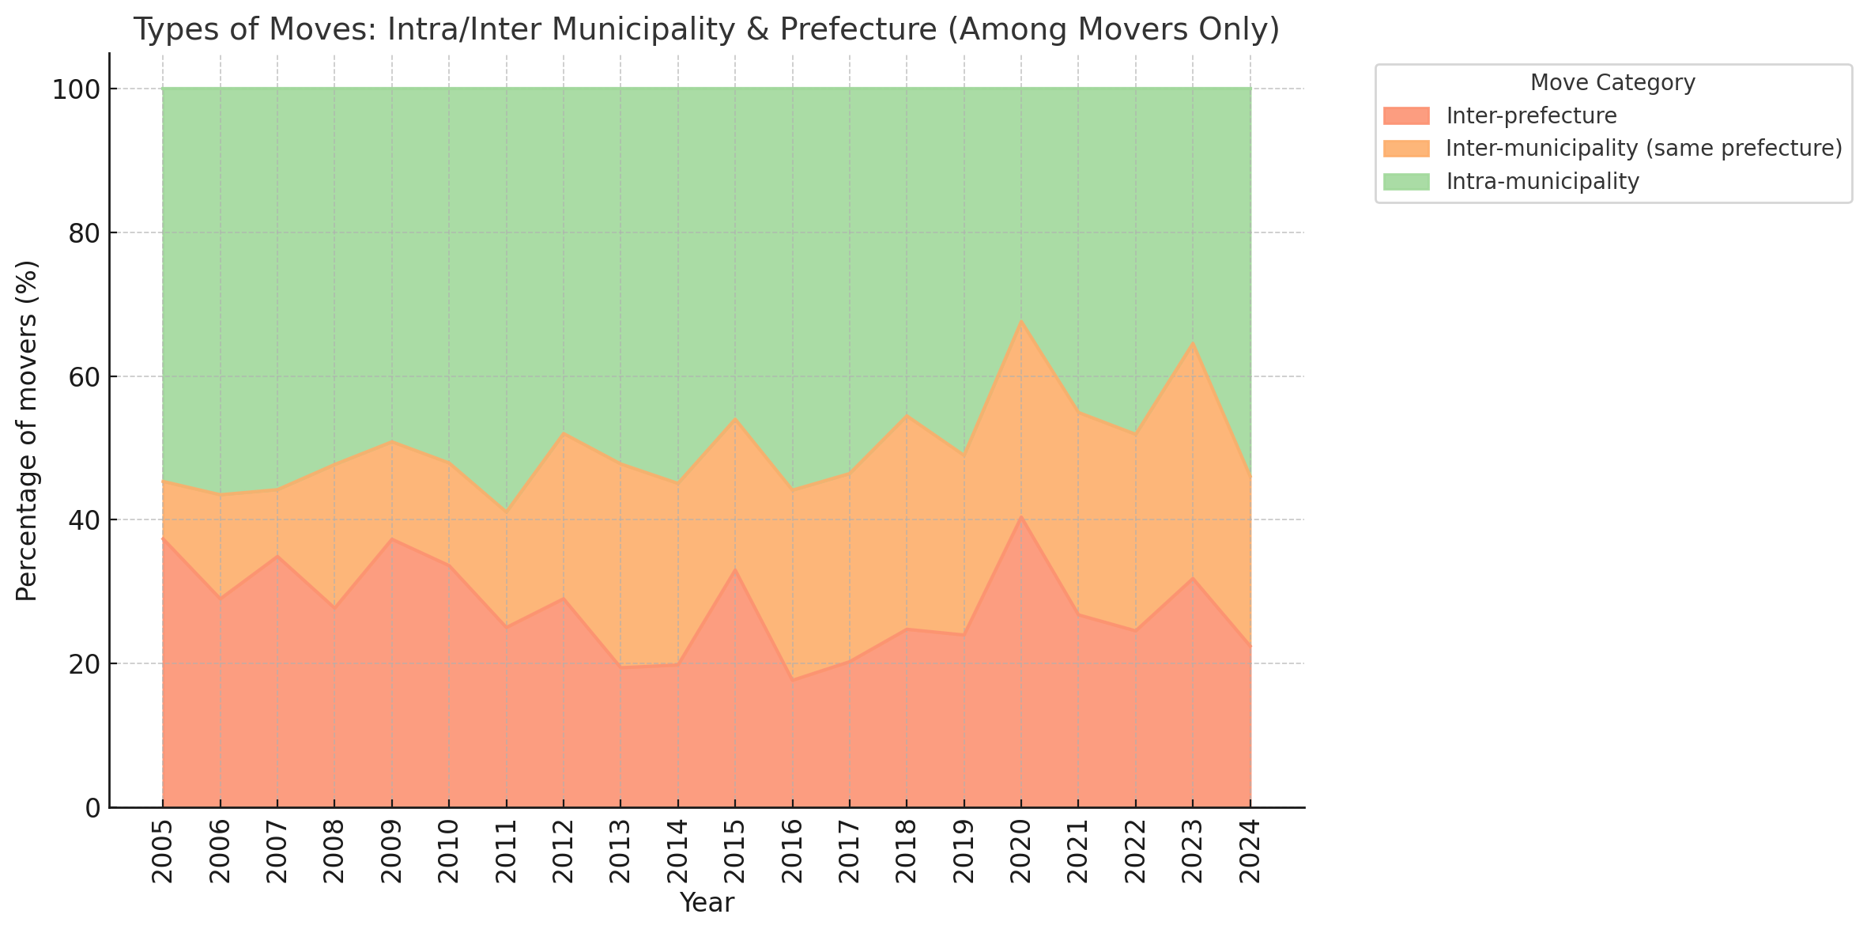
Before we dive too deep, lets see the data
Movers Destination (Municipality) Share
People tends to move within their previous municipality than move to another municipality (or another prefecture).
This is interesting because, there is no noticeable different trend in 2011 when the earthquake occurred.
Even we can see that 2011 has the highest share of moving to within-municipality in 20 years.

Slide 12
03
Model

Slide 13
Sequential Decision Model
Location
…
Loc5
Move
Loc4
Stay
Loc3
Loc2
Loc1
Move
Move
Before
Earthquake
After
Time

Slide 14
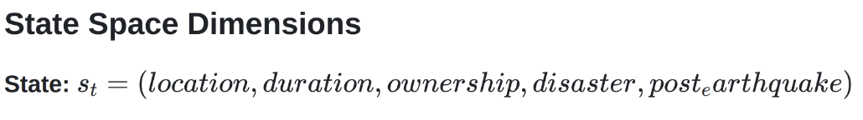
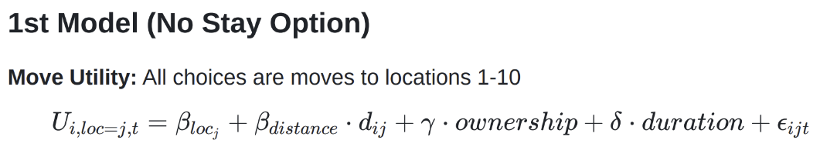
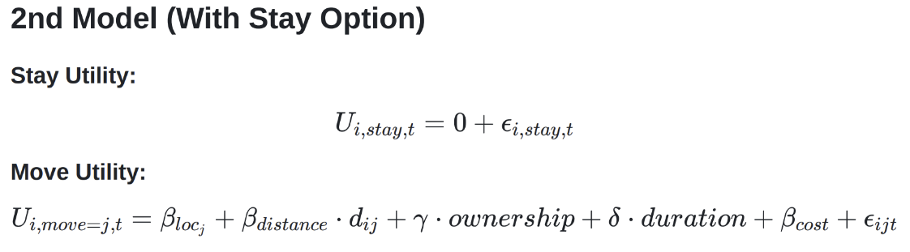
Model
Notes:
“Each year a person is in a state: where they live, how long they’ve been there, own/rent, disaster-affected or not, and whether it’s after 2011.
We try two versions:
Model 1: every option is a location to live next year (staying = picking the same place).
Model 2: we add an explicit Stay option and a move cost when you relocate.”

Slide 15
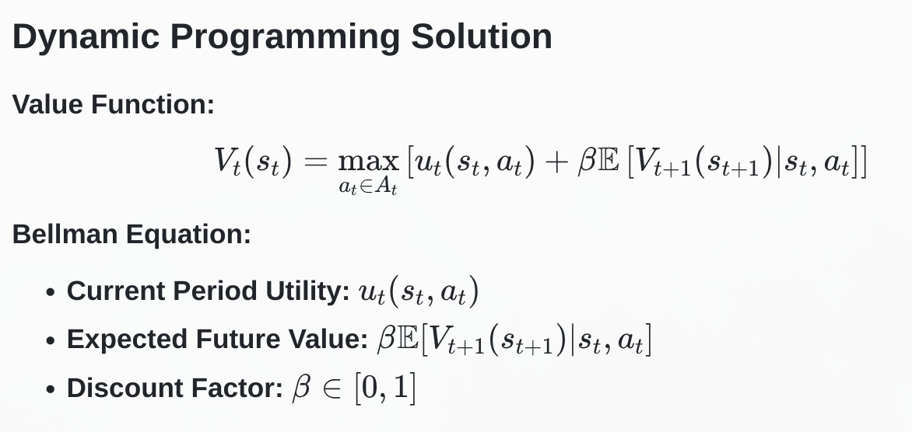
Model
Notes:
“We solve backwards: set the last year’s value equal to utility, then step back year by year using our transition rules to take expectations.”

Slide 16
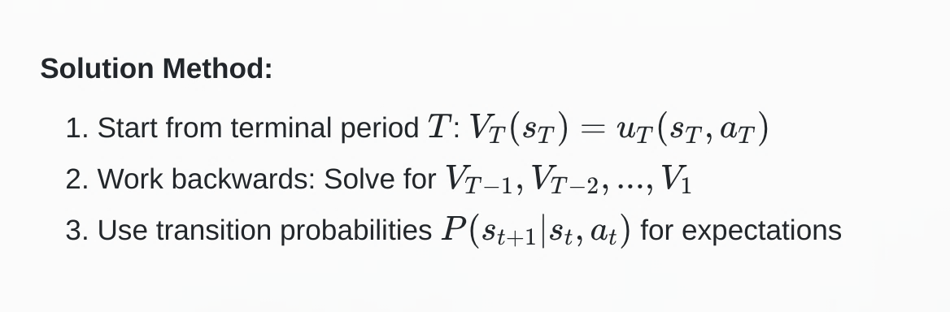
Model

Slide 17
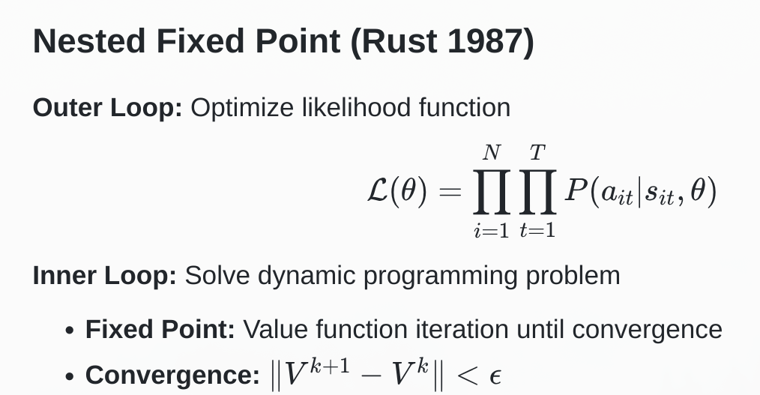
Model
Notes:
“To estimate parameters, we loop:
Inner loop: solve the model for a guess of parameters.
Outer loop: check how well those parameters predict people’s choices.
We adjust parameters to best fit the observed choices.”

Slide 18
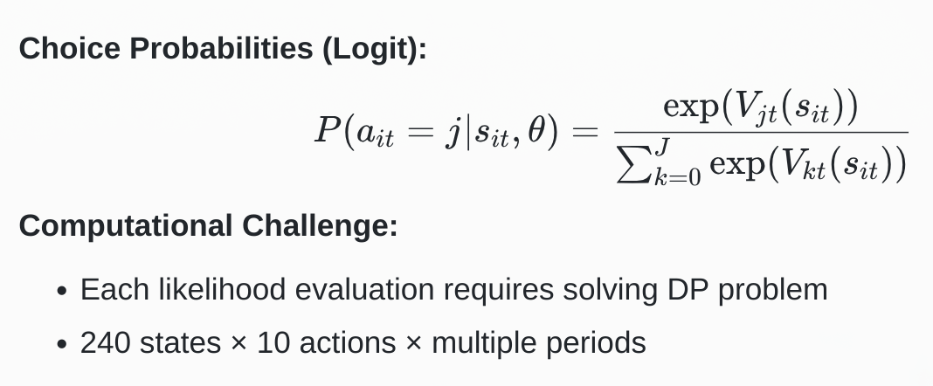
Model
Notes:
Given solved values, the chance of picking option j follows a logit: higher value → higher probability.

Slide 19
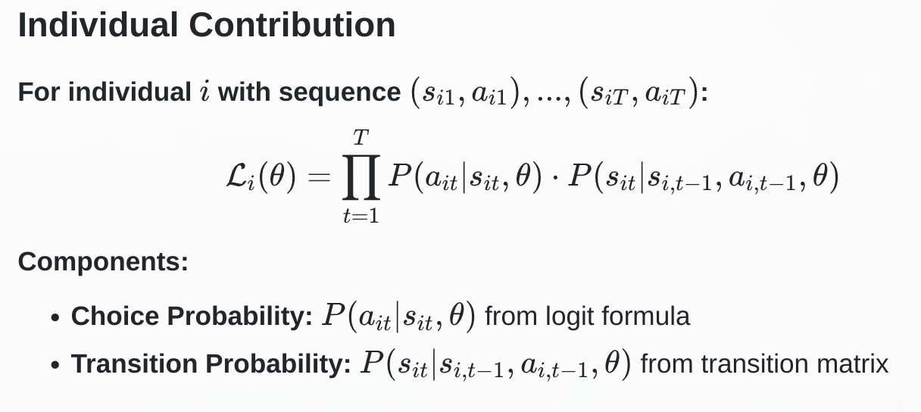
Model
Notes:
For each person and year, we multiply the probability of the choice and the next state. Sum logs over everyone. The best parameters are the ones that maximize this total.”

Slide 20
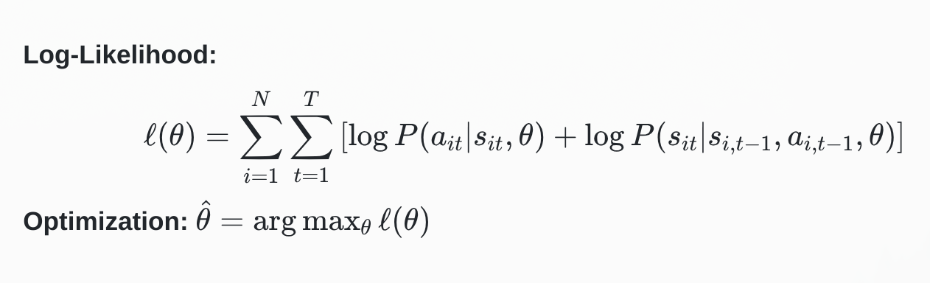
Model
Notes:
We sum the log-likelihood over all individuals and years and pick θ^\hat\thetaθ^ that maximizes it

Slide 21
04
Result

Slide 22
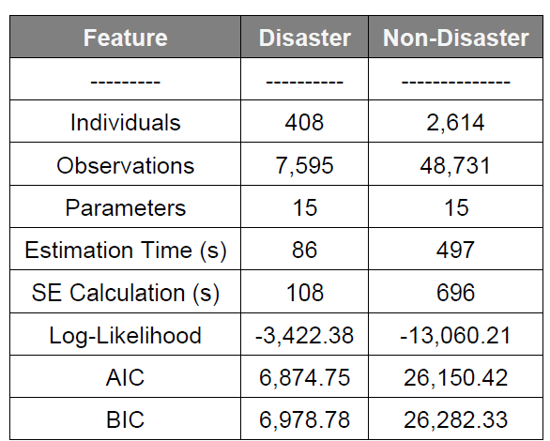
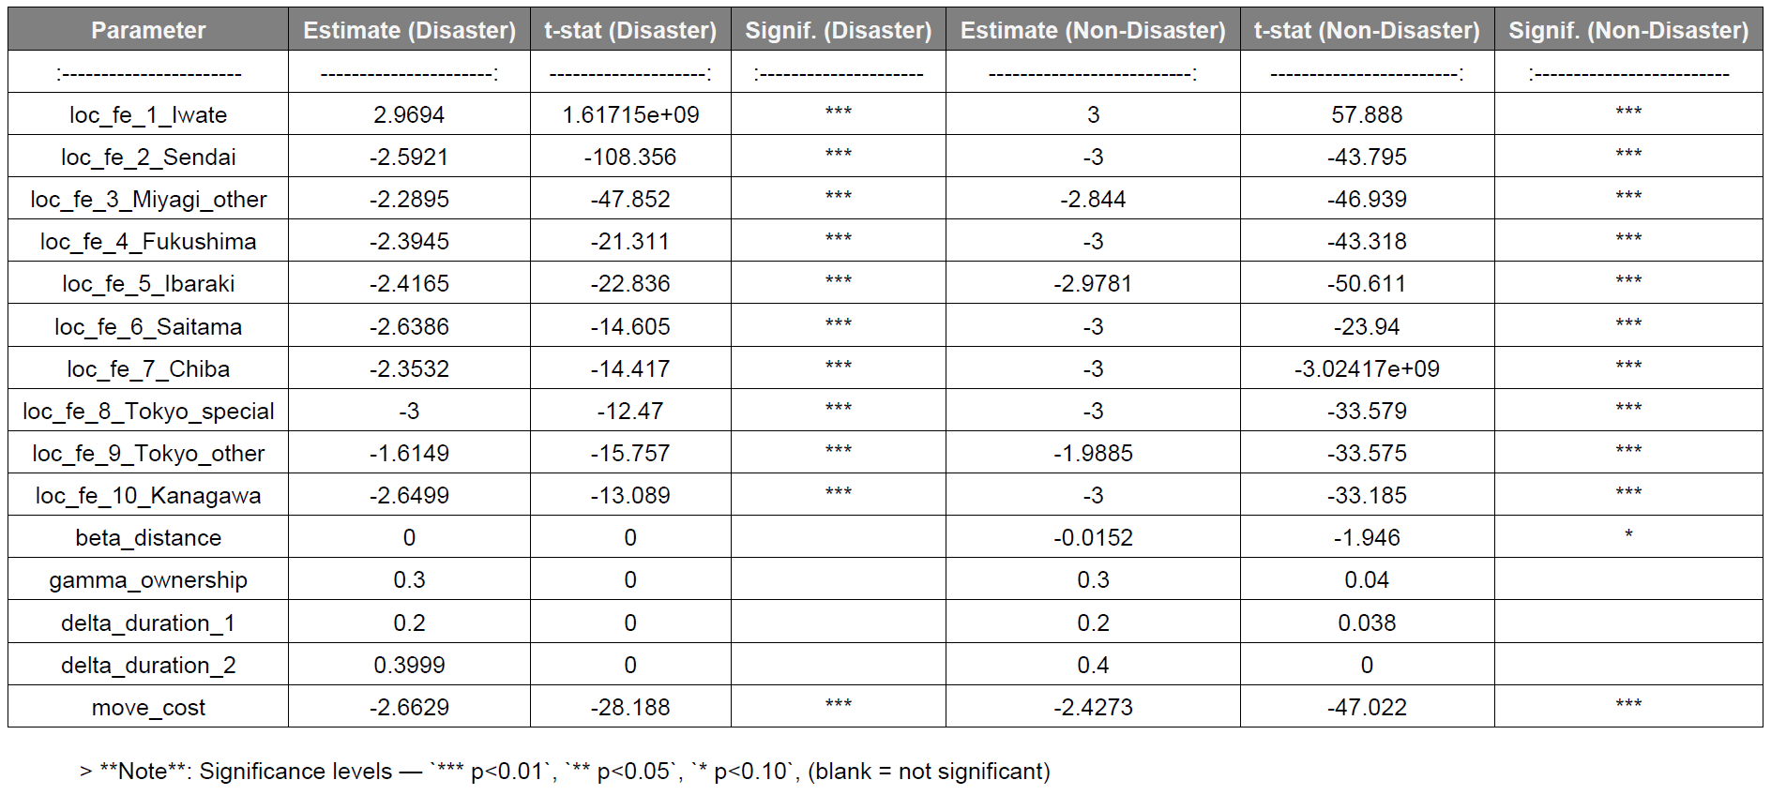
Result – 1st Model
1. Model Overview
2. Parameter Estimates with t-values
High absolute t-values (>2) indicate strong statistical significance.
Disaster and non-disaster populations differ most in distance effect (t ≈ 0 vs -1.95).
Moving cost highly significant in both cases (t ≈ -28 vs -47).
Ownership and duration effects show very low t-values → not statistically significant.
Location fixed effects generally highly significant (except normalization artifact for Iwate).

Slide 23
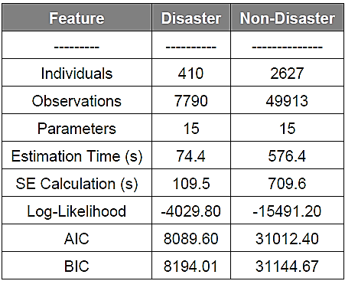
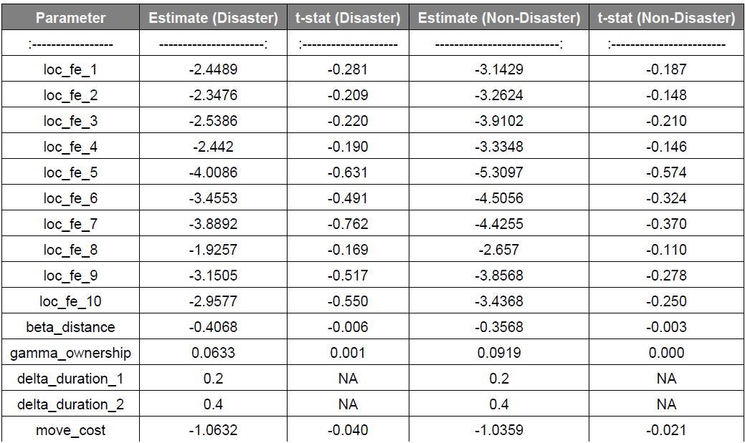
Result – 2nd Model
1. Model Overview
2. Parameter Estimates with t-values
- Location fixed effects: Estimates are all negative (vs staying), but none are statistically significant (t ≈ 0).
- Distance effect: Small negative values, but again not significant (t ≈ 0).
- Ownership & duration effects: Essentially non-significant.
- Moving cost: Much lower magnitude than in the simple model, but still not significant.
- Conclusion: Adding a “stay option” fundamentally shifts the scale of coefficients and reduces significance.
Notes:
Disaster victims show no distance sensitivity, relocating out of necessity rather than convenience. They are more willing than others to consider disaster-affected areas, though Tokyo remains most attractive for both groups. Moving costs are universally high, creating strong inertia and explaining the 94% staying rate.
Policy: Financial Assistance Programs, Regional development

Slide 24
Thanks!

