Slide 1


Introduction to Transportation Behavioral Modelling
Arnab Jana, PhD
Associate Professor
Department of Civil Engineering
Indian Institute of Technology Bombay
September 22, 2025
University of Tokyo

Slide 2
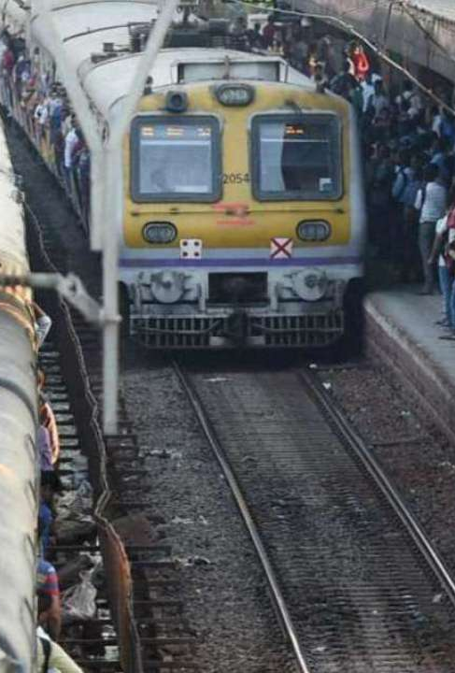

Why are we interested in Travel Demand Modelling?
Forecast - Transportation Demand
Travel analysis incorporates a wide spectrum of topics as part of regional transportation planning activities. In general, travel analysis is performed to assist decision makers in making informed transportation planning decisions. The strength of modern travel demand forecasting is the ability to ask critical “what if” questions about proposed plans and policies.
Changes in the Attributes
Transportation system
People
User
Vehicle/ Carrier
Roadway/ Facility
Environment

Slide 3
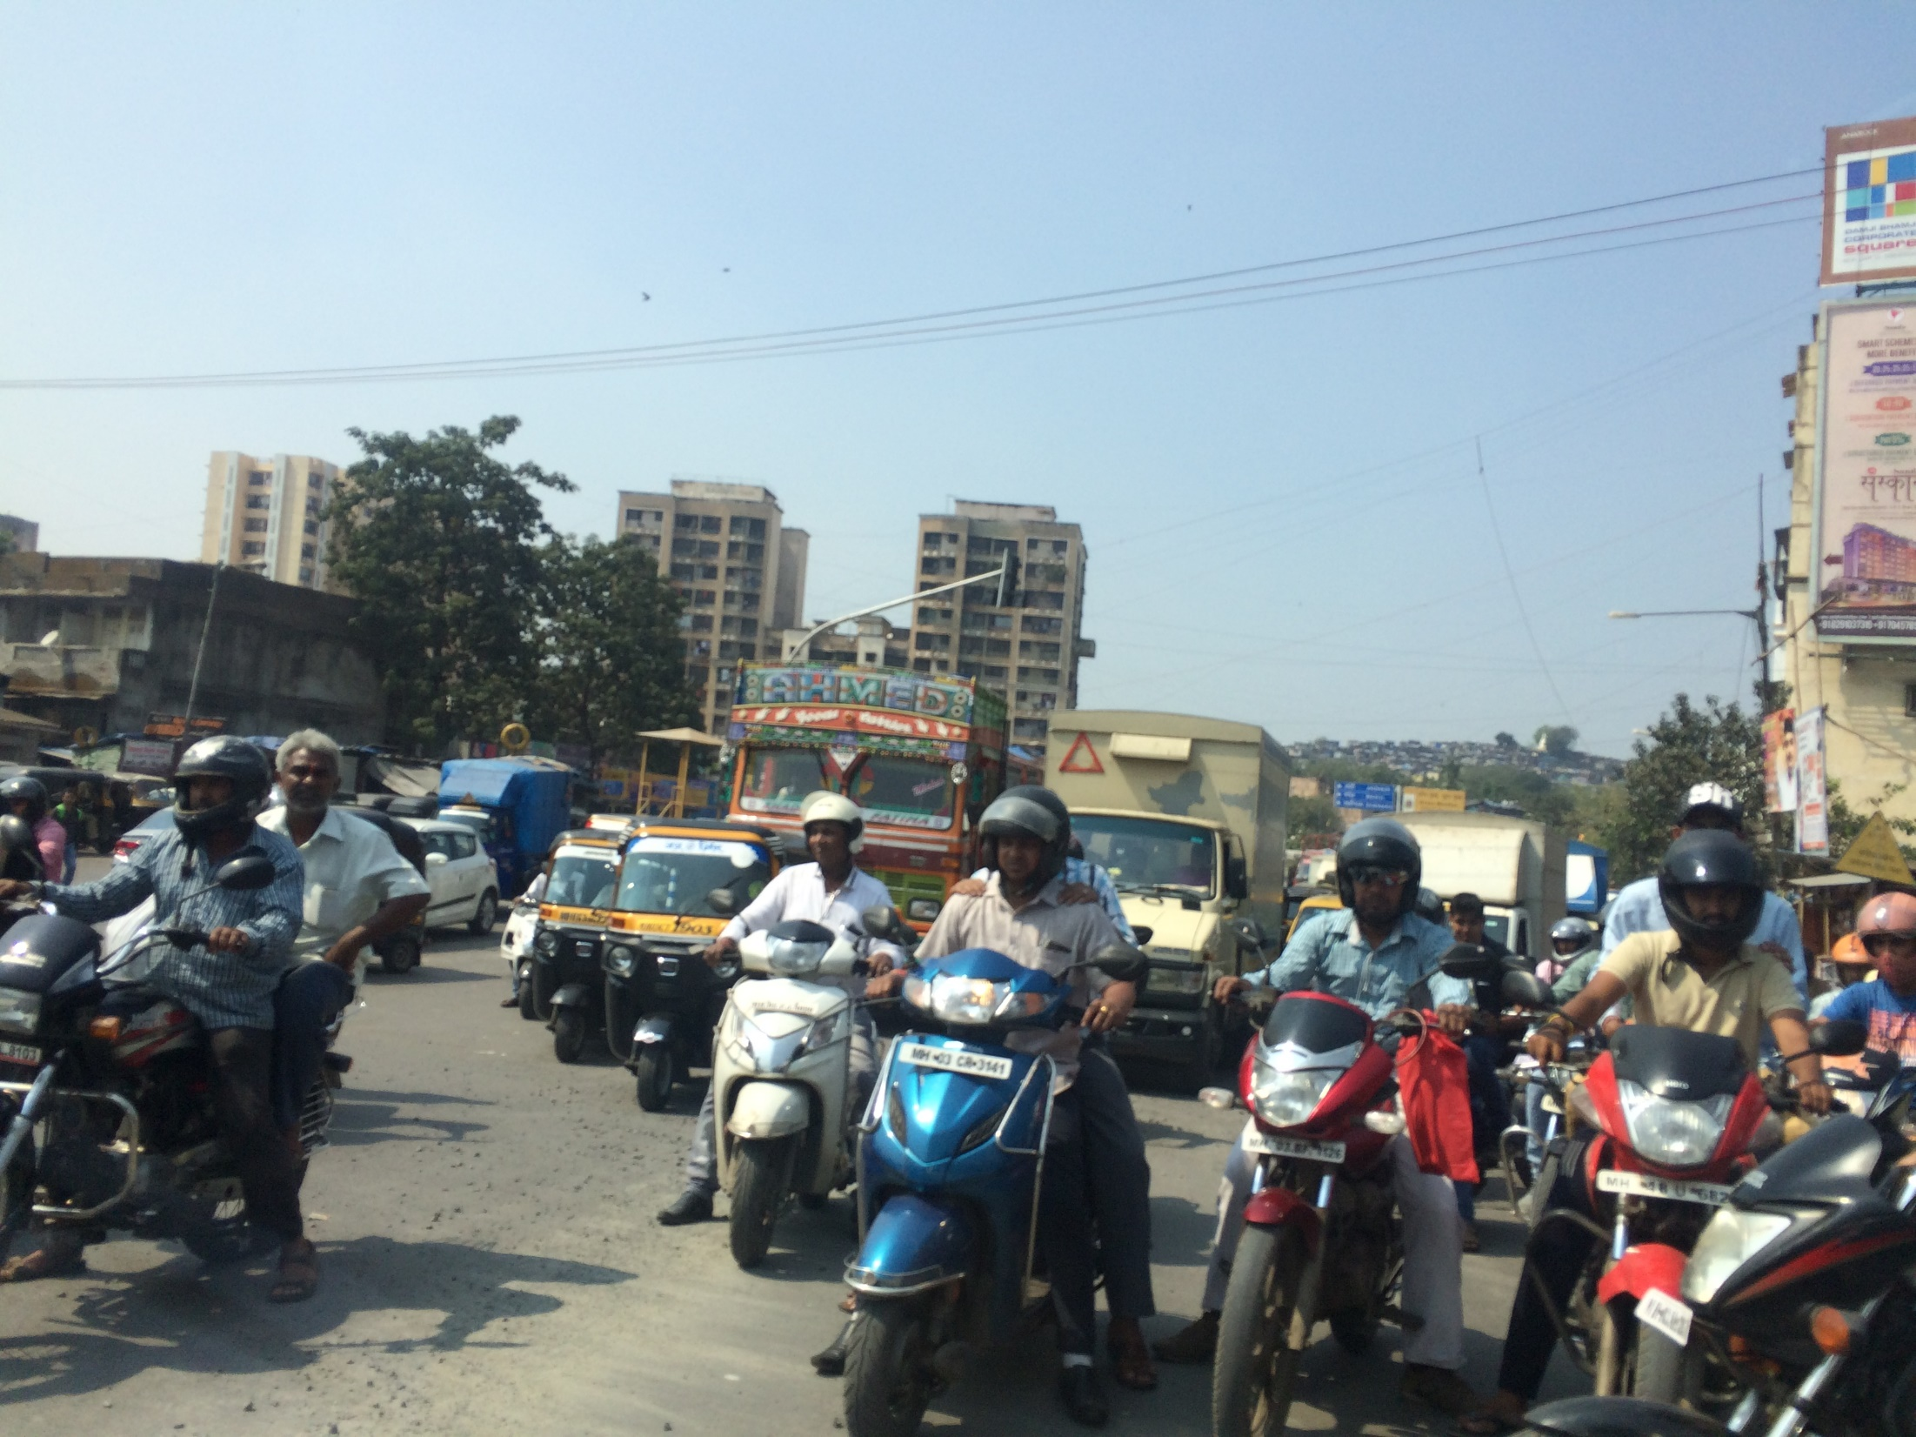

Slide 4
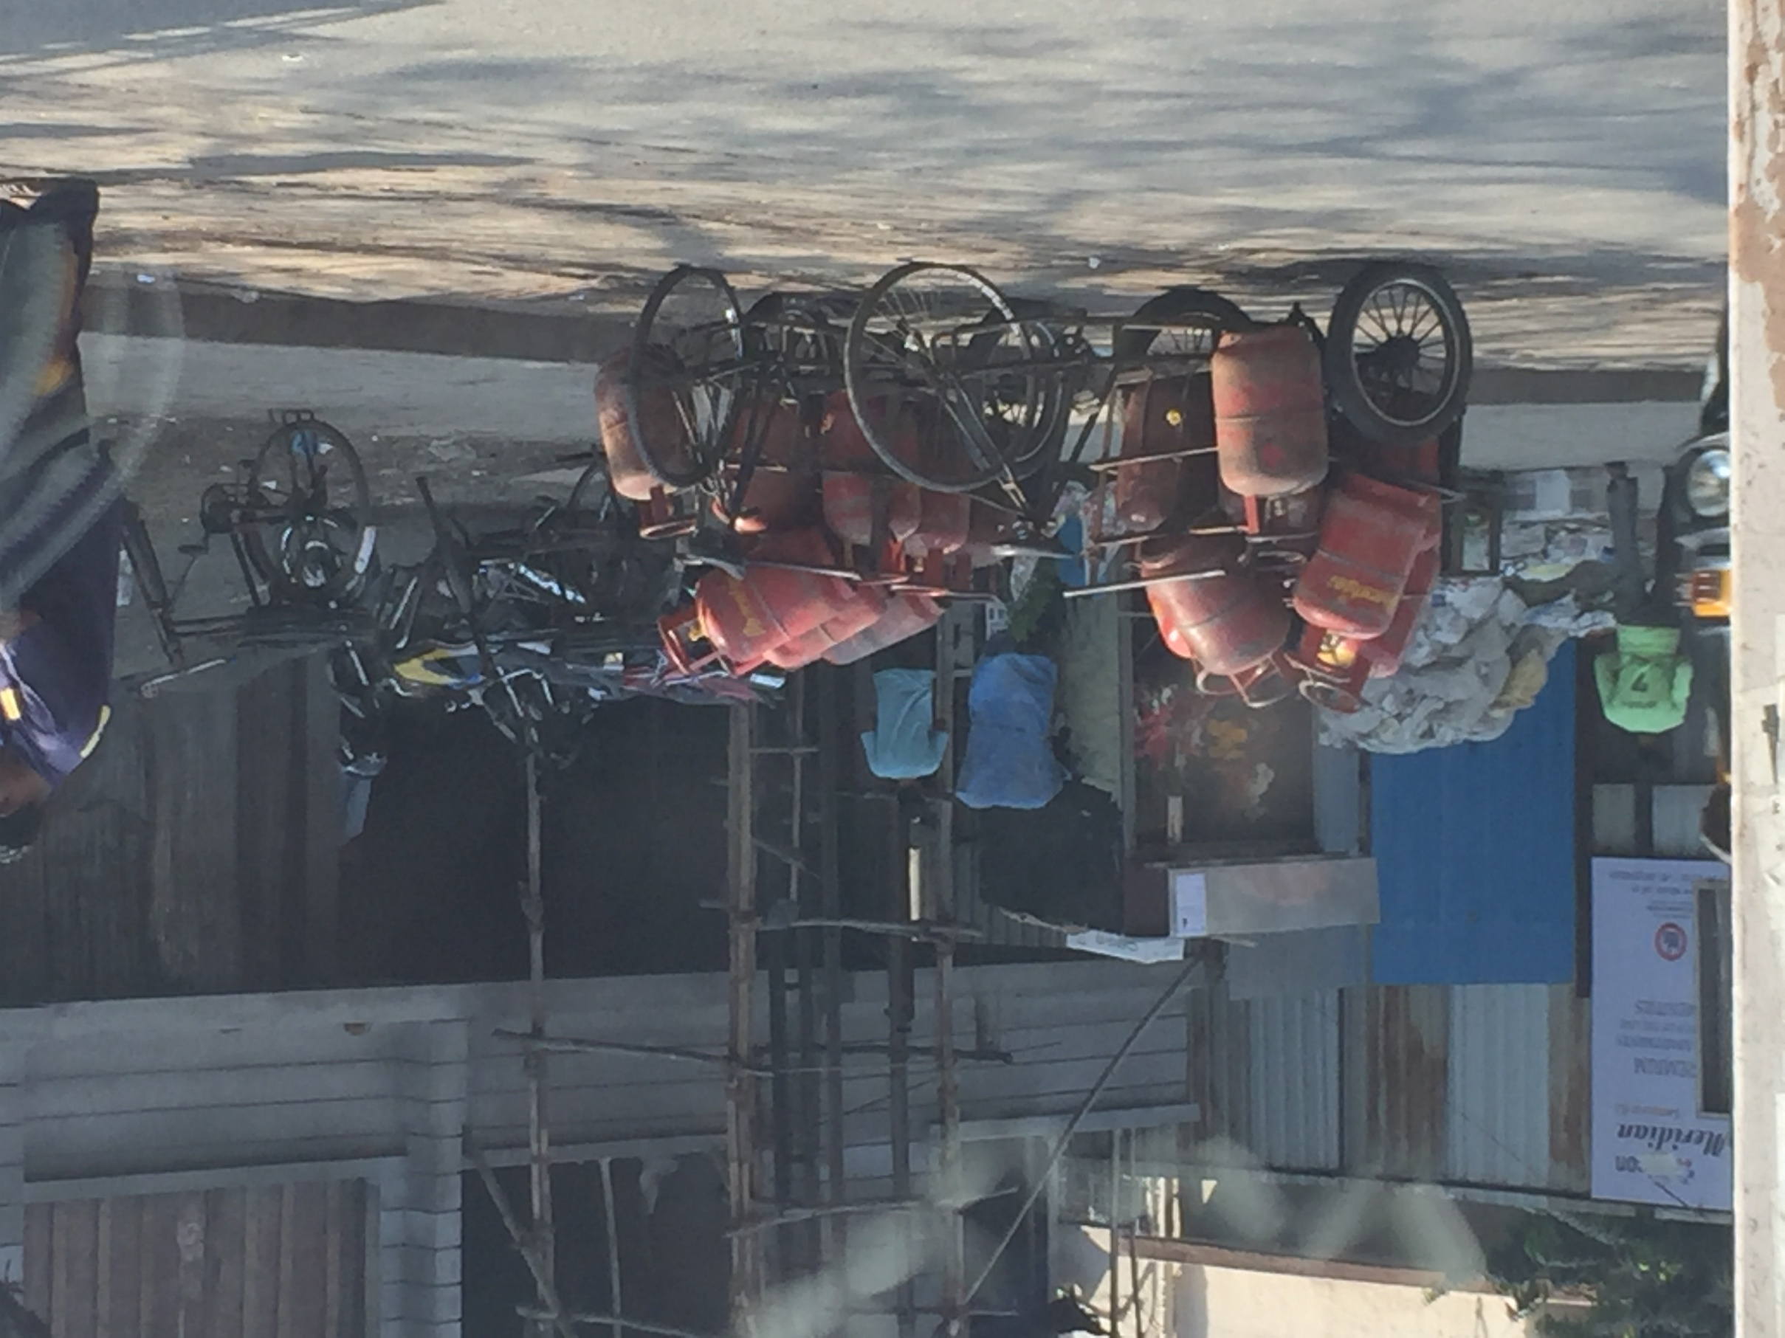
Goods and Vehicles that are often seen in cities of developing nations BUT….

Slide 5
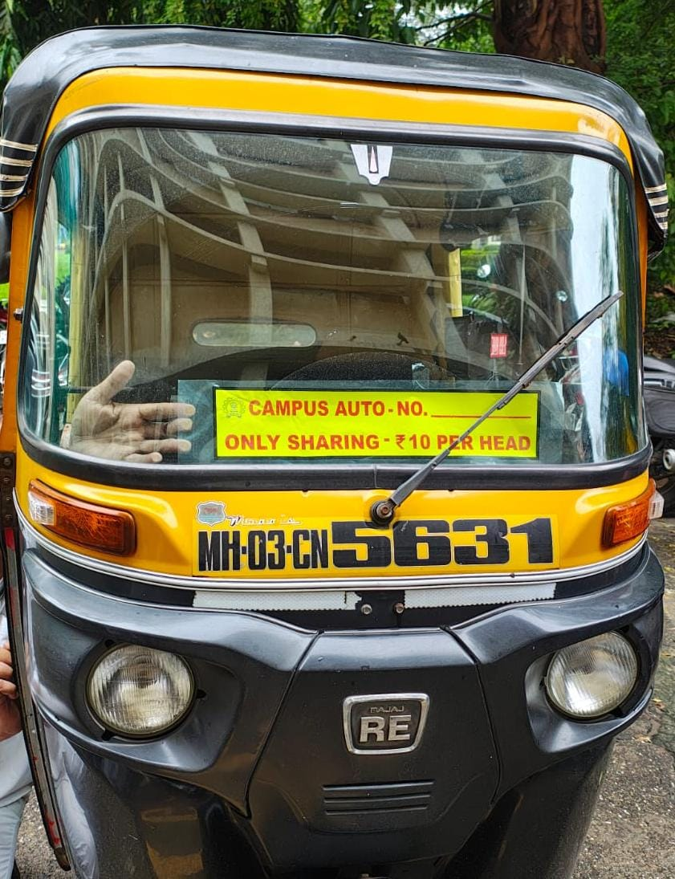
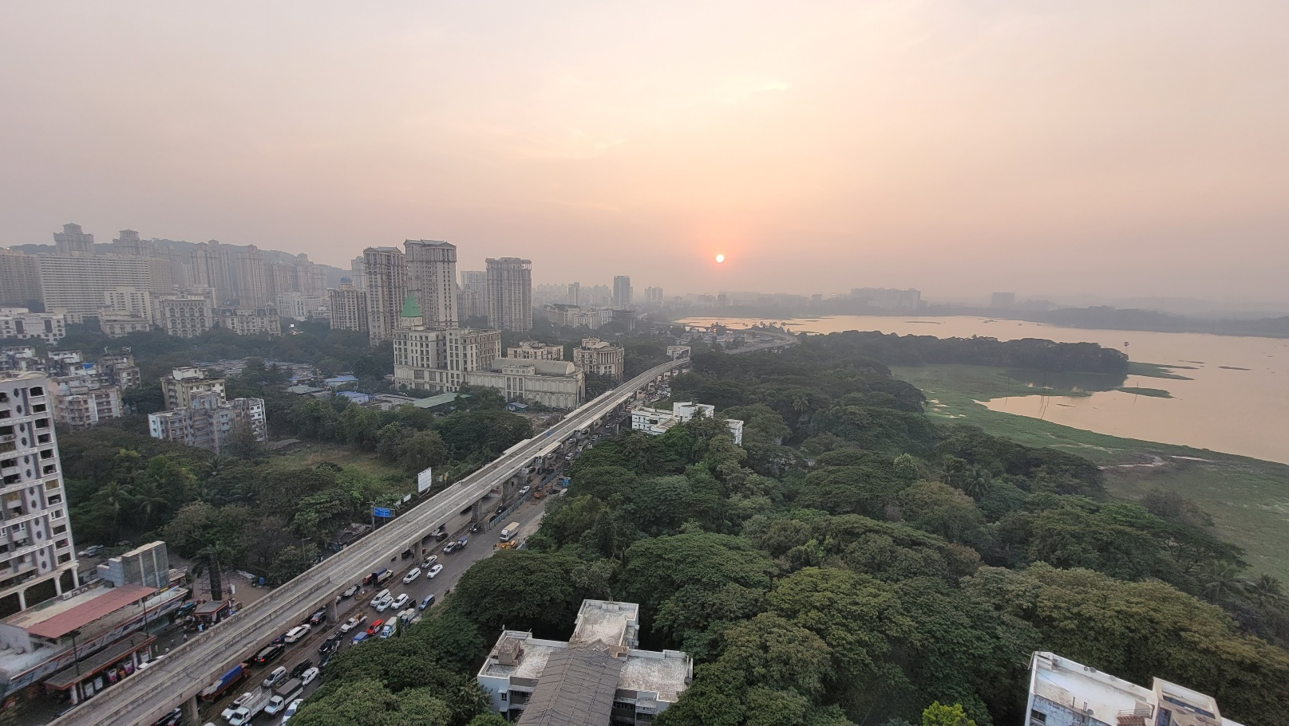
Connectivity

Slide 6
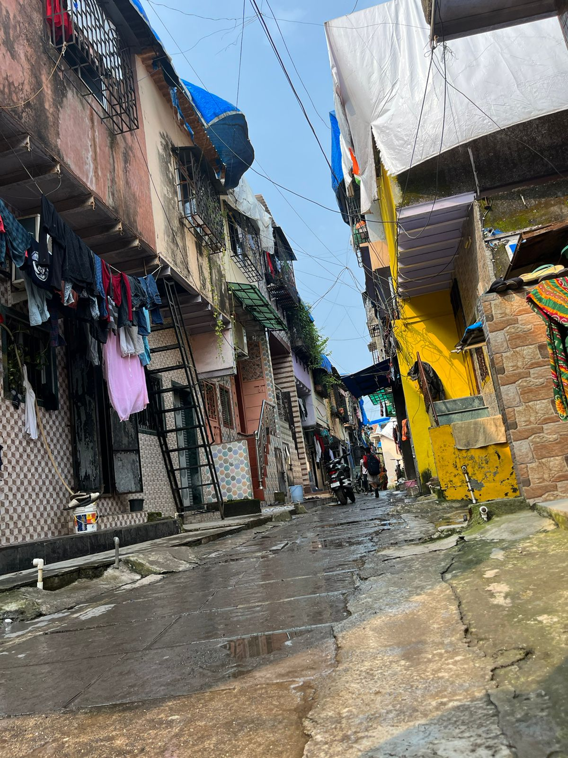
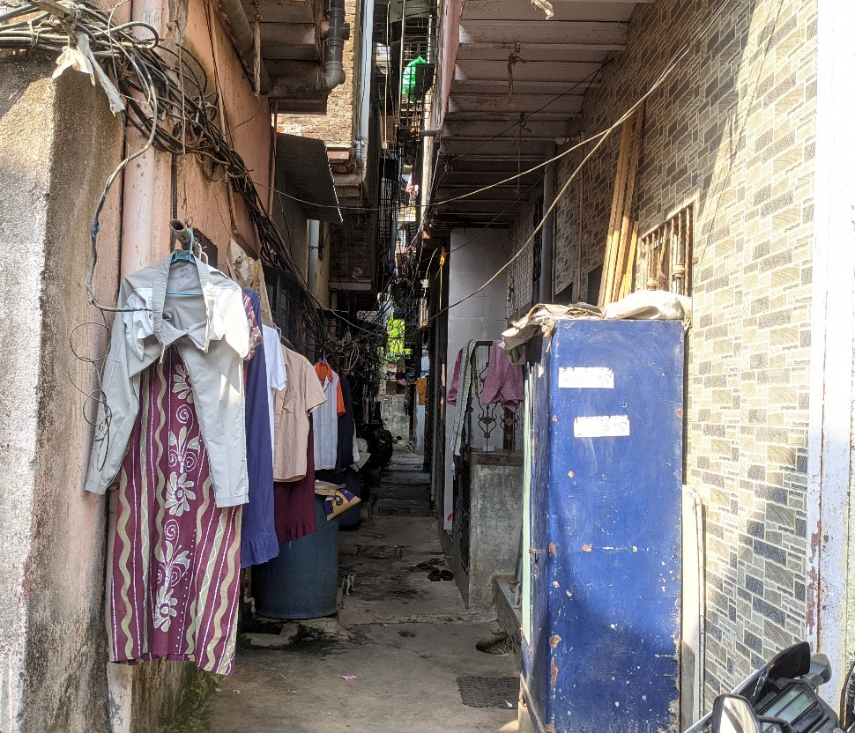
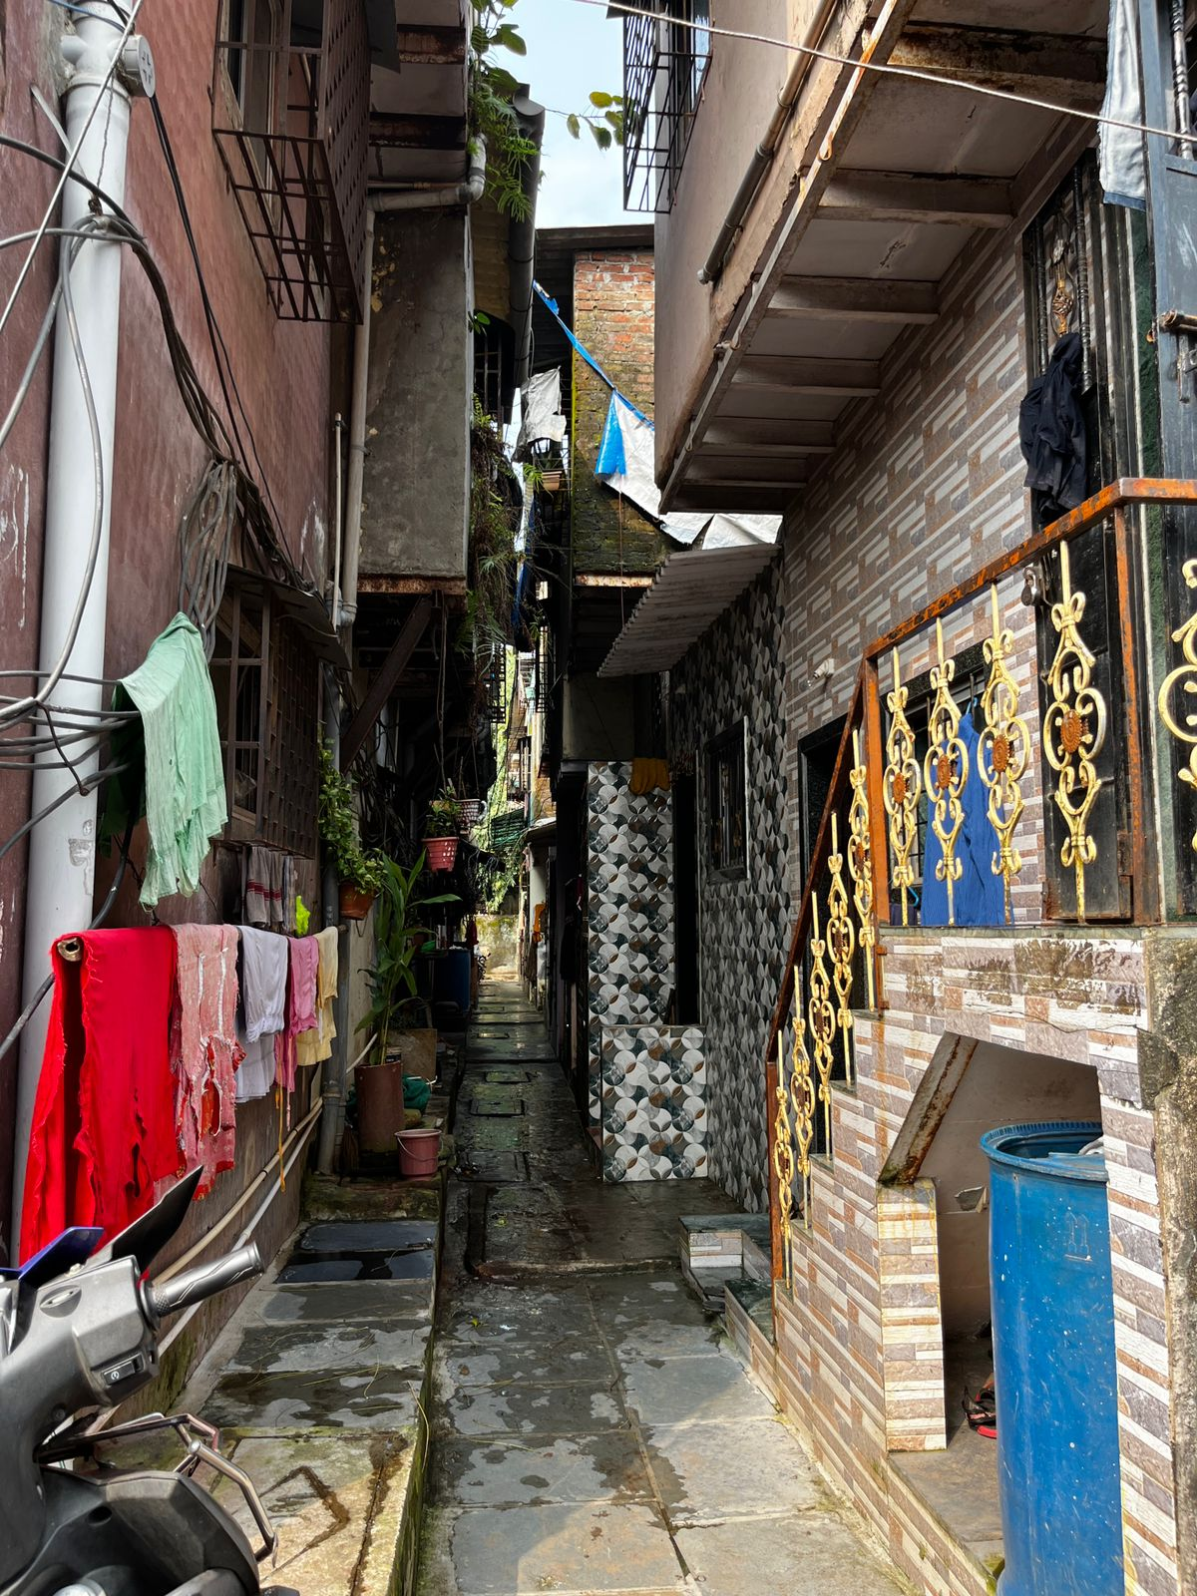
Street Geometry: Is walking a CHOICE?

Slide 7
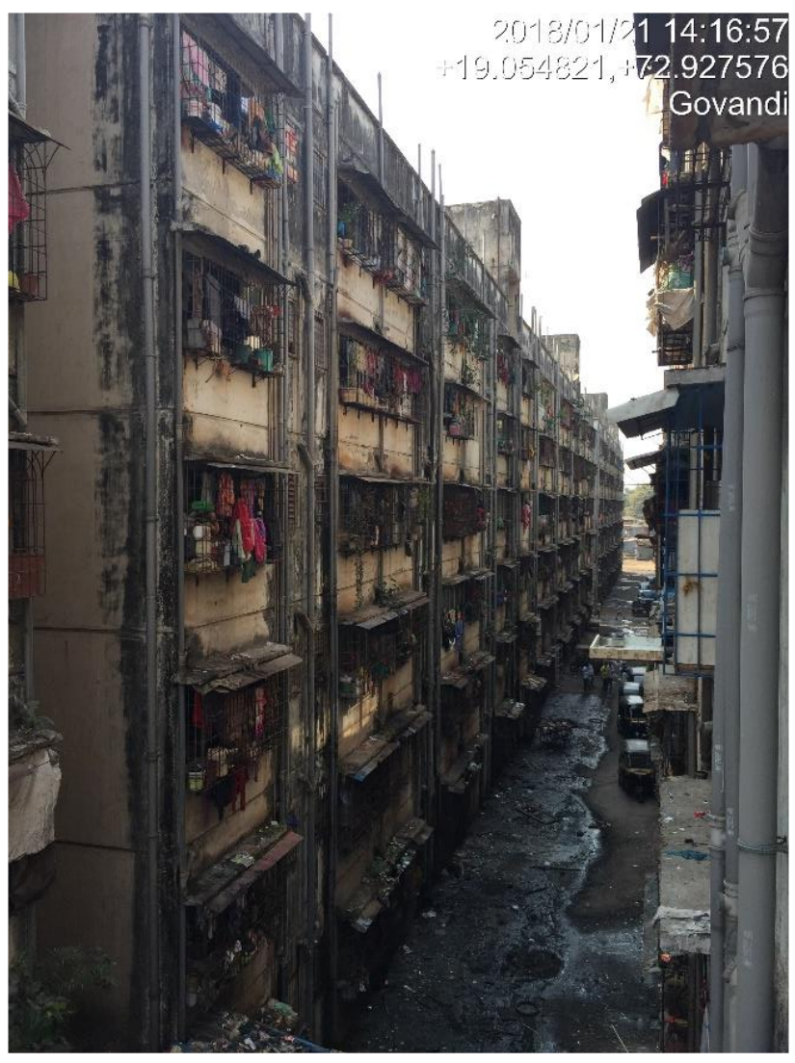

Slide 8
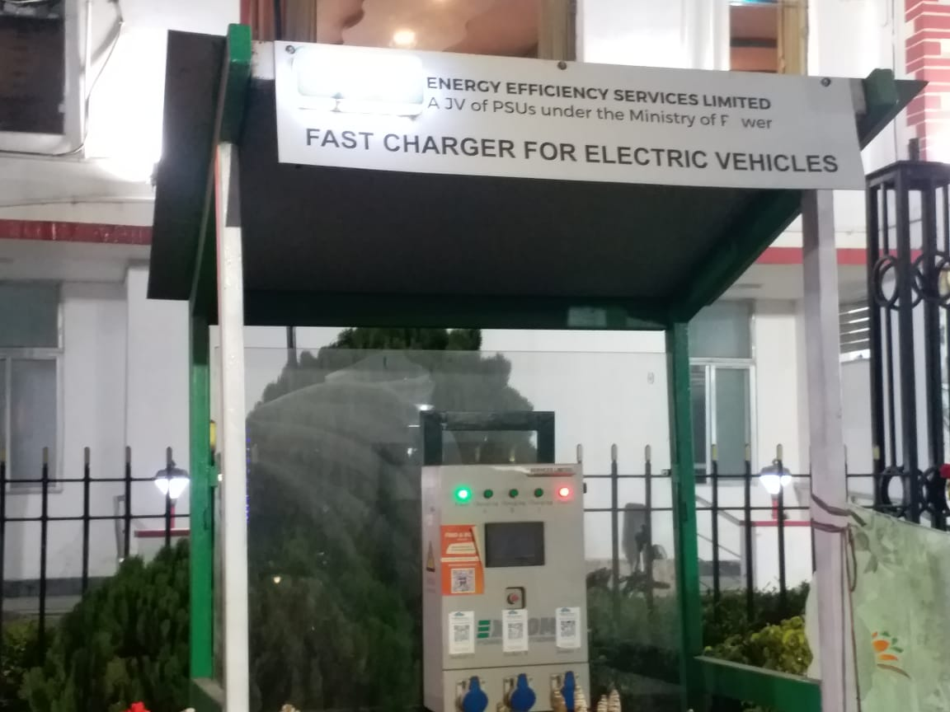
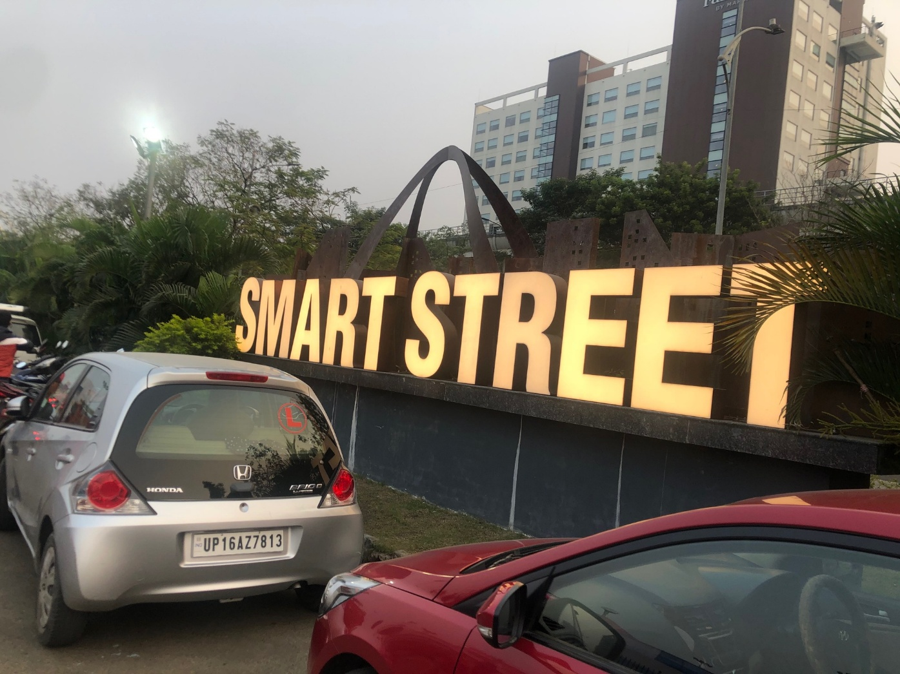

Slide 9
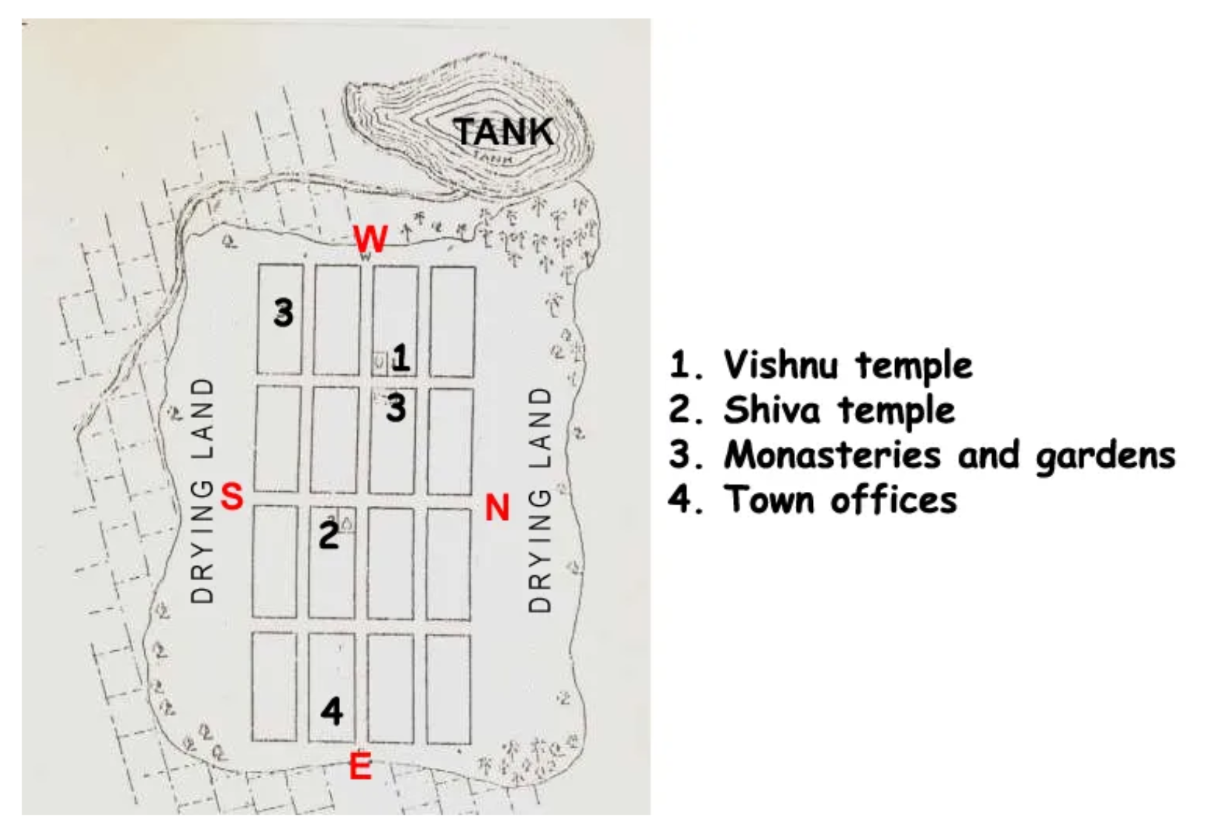
Dandaka

Slide 10
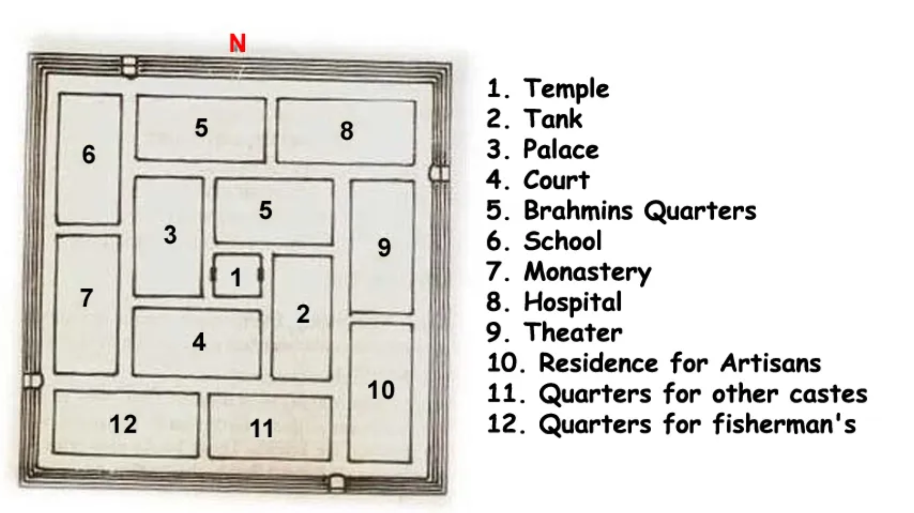
Nandyavarta

Slide 11
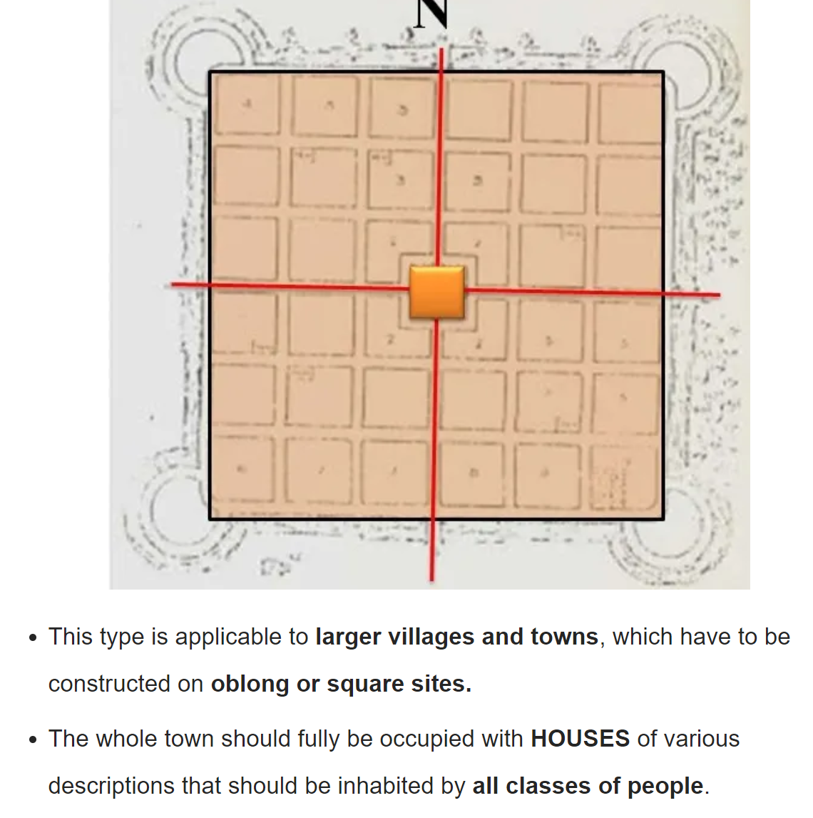
Sarvathobadra

Slide 12
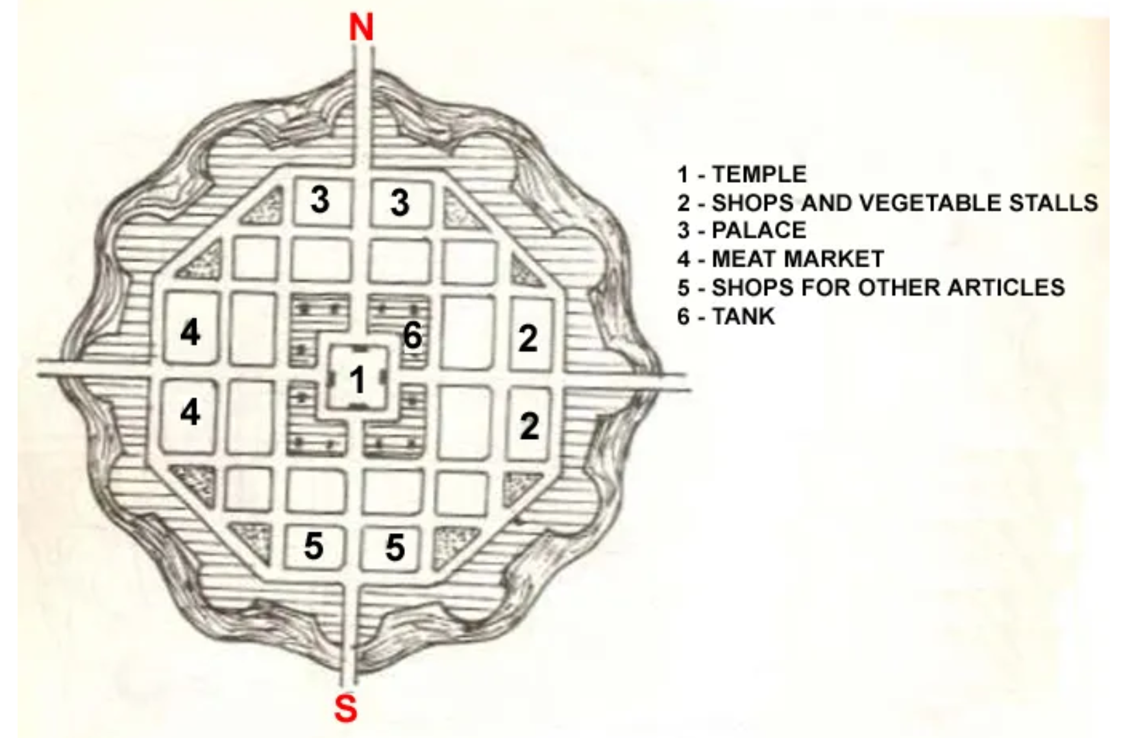
Padmaka (Lotus Petal)

Slide 13
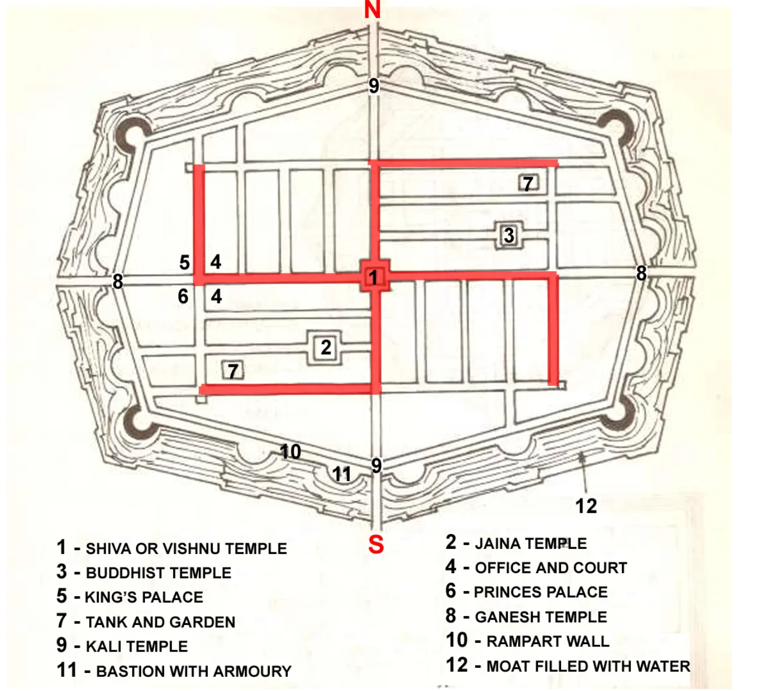
Swastika

Slide 14
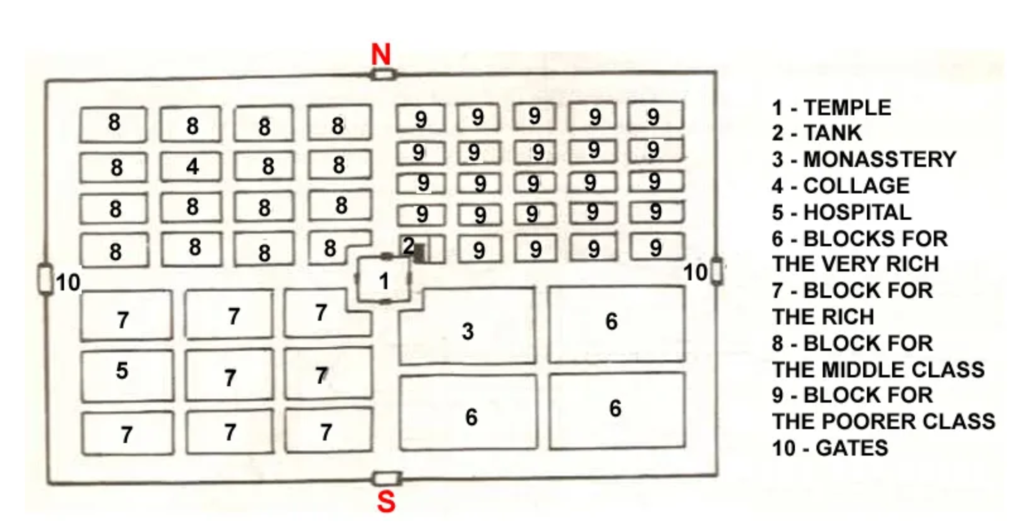
Prastara

Slide 15
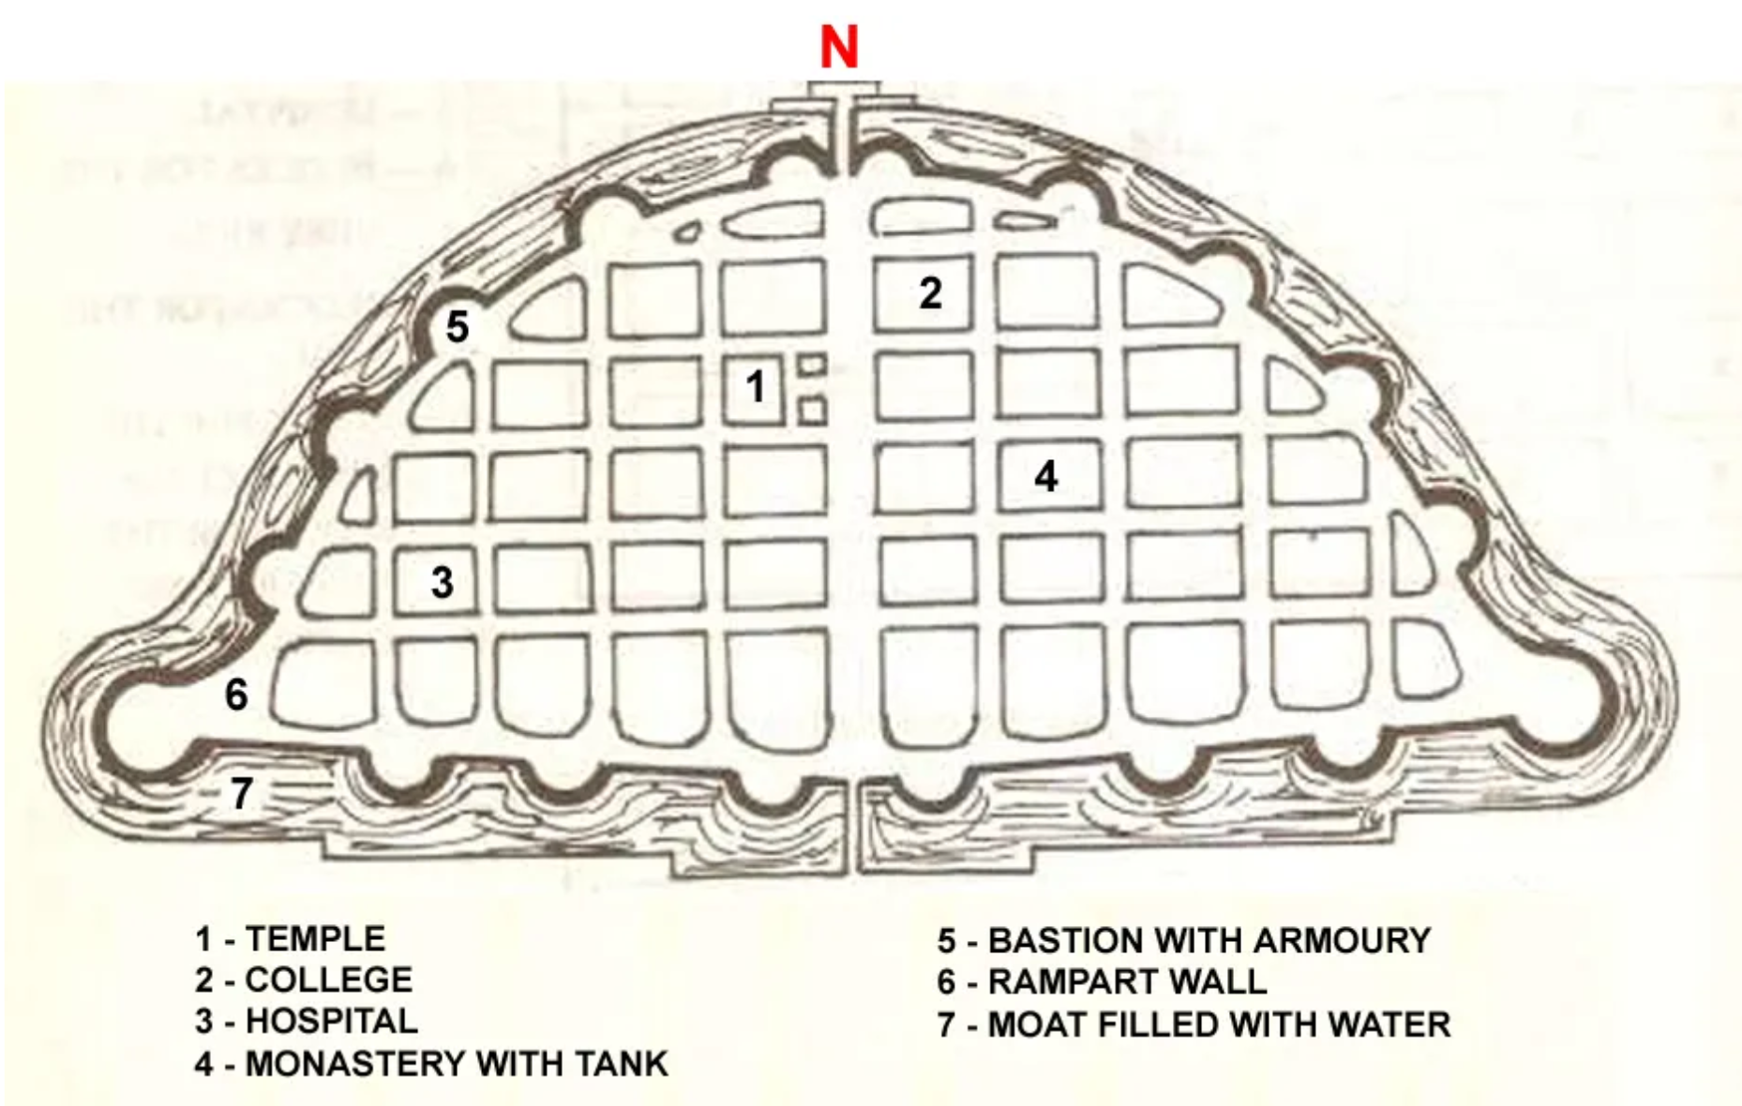
Karmuka

Slide 16
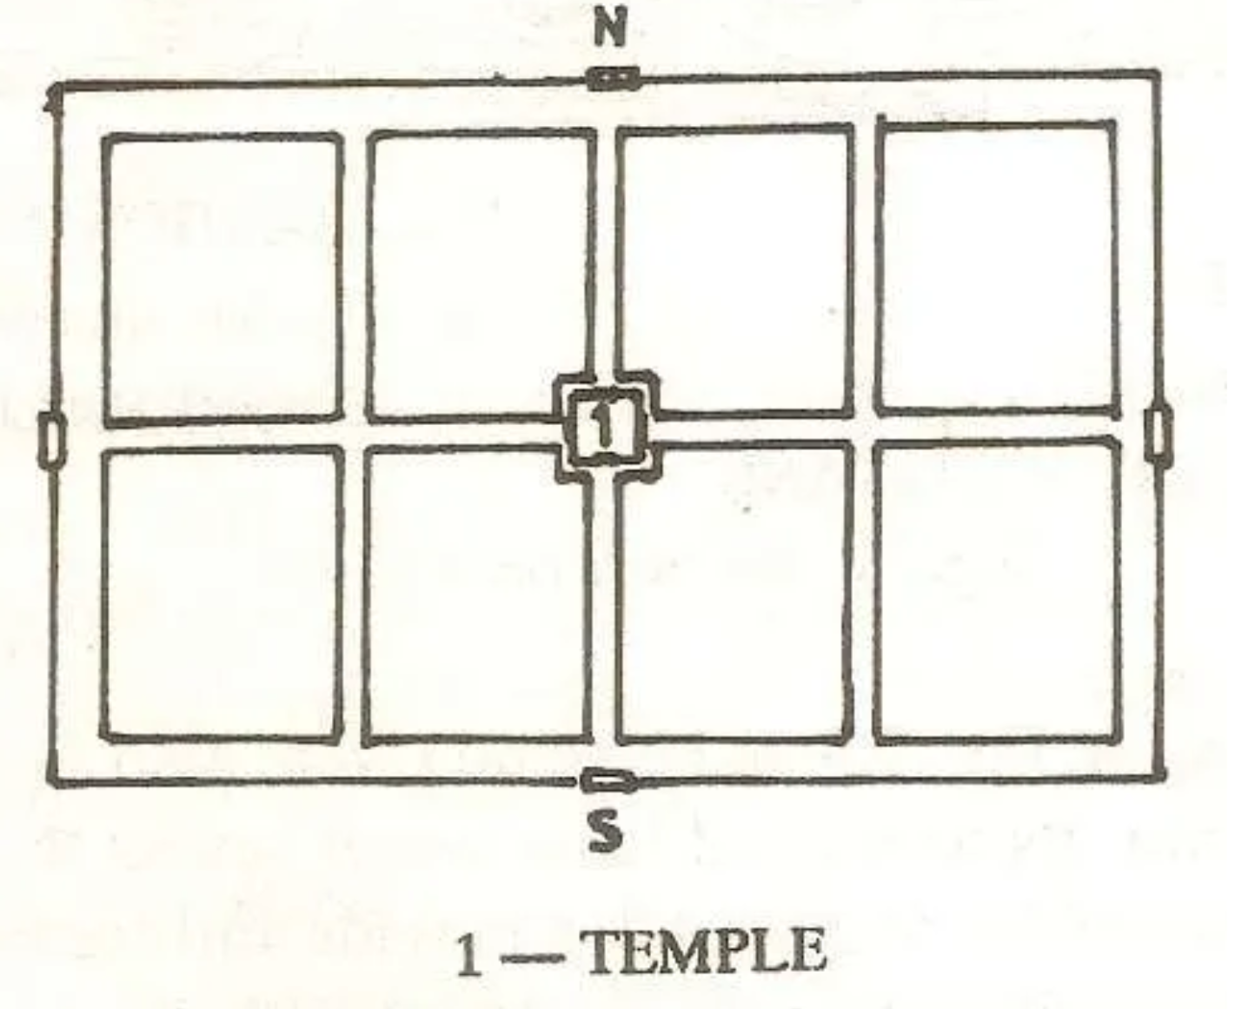
Chaturmukha

Slide 17
Contents
Introduction to four step model
Choice Models
Activity Based Modelling Approach

Slide 18
Introduction
Demand for Travel is a derived Demand
Components of Transportation System
    User
    Vehicle/ Carrier
    Roadway/ Facility
    Environment
Transportation systems problems
    Congestion
    Pollution
    Safety
    Parking

Slide 19
Four step model

Slide 20
Four step model
Inputs
Transportation system Characteristics
Land use – activity system characteristics
Urban Transportation model system
❶Trip Generation (How many trips)
❷Trip Distribution (Where do they go?)
❸Mode Choice (By what mode?)
❹Traffic Assignment (By what route?)
Outputs
Traffic flow on network
Quantity (Volume)
Quality (Speed)

Slide 21
Four step model
❶
Oi
Dj
Trip generation
ZONE I
ZONE J
❷
Tij
ZONE I
ZONE J
Trip distribution
❸
TijM1
ZONE I
ZONE J
Modal split
TijM2
❹
ZONE I
ZONE J
Assignment
Route taken by flow TijM1

Slide 22
Example
Tijmrsp
Tijmrs
(Income)
Edud.
2
Work
6
High
3
Other
1
Medium
5
9
Low
9
Pi
17
ZONE 1
Pi: 47; Aj: 45
Production
1
47
F
r
o
m
Z
o
n
e
s
To Zones
Tijm
Tijmr
2
66
1
2
3
1
10
18
19
47
Mode I
25
Route A
5
3
110
ZONE 2
Pi: 66; Aj: 90
Mode II
15
Route B
17
2
30
32
4
66
3
5
40
65
110
40
Route C
3
Aj
45
90
88
223
Tijmrp
Attraction
Trip Purpose
ZONE 3
Pi: 110; Aj: 88
1
45
Education
3
2
90
Work
12
3
88
Other
2
17

Slide 23
❶Trip Generation
Aims at predicting the total number of trips generated by (Oi) and attracted to (Dj) each zone of the study area
Trip or Journey: This is a one-way movement from a point of origin to a point of destination
Home-based (HB) Trip This is one where the home of the trip maker is either the origin or the destination of the journey
Non-home-based (NHB) Trip This, conversely, is one where neither end of the trip is the home of the traveler

Slide 24
Classification of Trips
travel to work
travel to school or college (education trips)
shopping trips
social and recreational journeys
escort trips (to accompany or collect somebody else)
other journeys

Slide 25
❷Trip Distribution
The purpose of the trip distribution is to estimate ‘zone to zone’ movements, i.e., trip interchanges
Gravity Model
Probability that a trip of a particular purpose k produced at zone i will be attracted to zone j, is proportional to the attractiveness or ‘pull’ of zone j, which depends on two factors.
One factor is the magnitude of activities related to the trip purpose k in zone j, and the other is the spatial separation of the zones i and j.

Slide 26
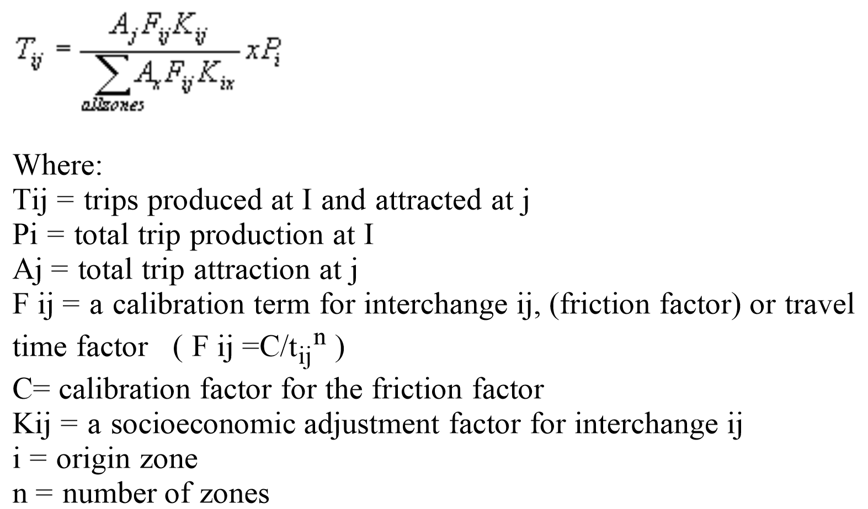
❷Trip Distribution: Gravity Model
The gravity model assumes that the trips produced at an origin and attracted to a destination are directly proportional to the total trip productions at the origin and the total attractions at the destination.
The calibrating term or "friction factor" (F) represents the reluctance or impedance of persons to make trips of various duration or distances.
The general friction factor indicates that as travel times increase, travelers are increasingly less likely to make trips of such lengths.
Standard form of gravity model

Slide 27
❸Mode Choice
Relates the probability of transit usage to explanatory variables in mathematical form
Factors Affecting Mode Choice
Factors that may explain a trip maker’s choosing a specific mode of transportation for a trip are grouped commonly as follows:
Trip Makers Characteristics:
  Income
  Car-Ownership
  Car Availability
  Age
Trip Characteristics:
  Trip Purpose - work, shop, recreation, etc.
  Destination Orientation - CBD vs. non-CBD
  Trip Length
Transportation Systems Characteristics
  Waiting time
  Speed
  Cost
  Comfort and Convenience
  Access to terminal or transfer location

Slide 28





❸Mode Choice
Bus - 40 minutes
I chose CAR
Car - 35 minutes
Actual Behavior – Reveled Preference (RP) Data

Slide 29

❸Mode Choice
Bus - 40 minutes
A new service introduced
Metro - 15 minutes
If new service is introduced, I will chose Metro
Car - 35 minutes
Hypothetical Behavior – Stated Preference (SP) Data

Slide 30
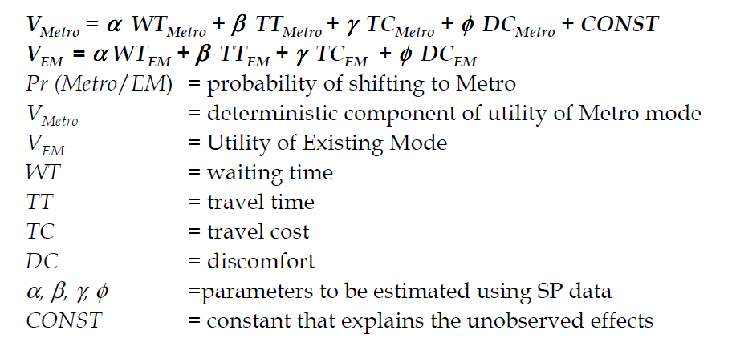

❸Mode Choice
$P_{Metro}=\frac{exp⁡(v_{Metro})}{\exp\left(v_{Metro}\right)+exp⁡(v_{EM})}$

Slide 31
❹Traffic Assignment
Allocates the trips between each zone pair to the links comprising the most likely travel routes.
The trips on each link are accumulated and the total trips on each link are reported at the end of the assignment process
        All or Nothing Assignment
        User Equilibrium

Slide 32
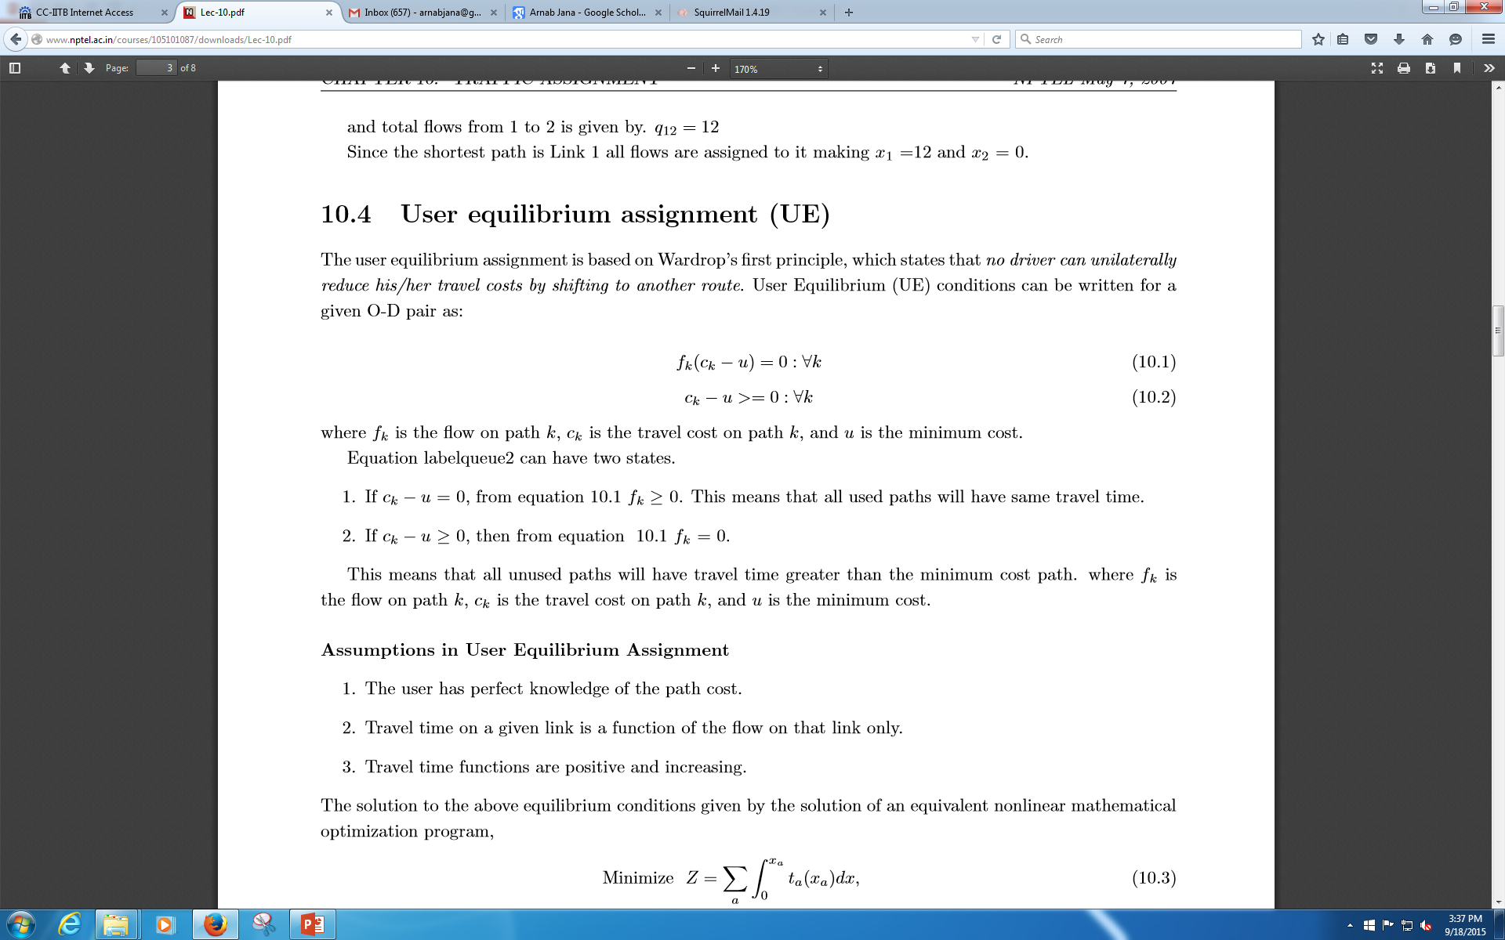
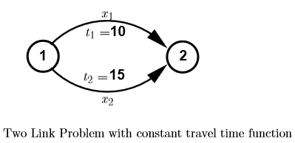
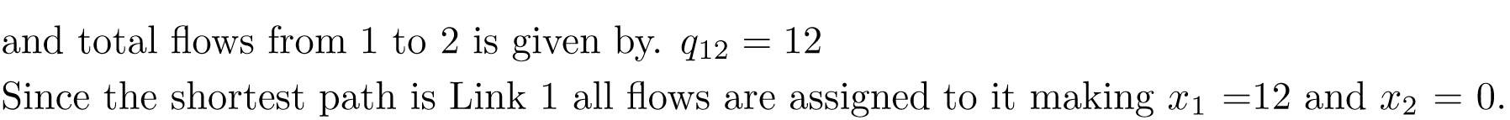
❹Traffic Assignment
All or nothing
Trips from any origin to any destination is loaded into a single, minimum cost path between them
Limitations:
  Unrealistic as only one path is utilized
  No consideration for capacity or congestion – travel time is a fixed input
User Equilibrium (UE)
The user equilibrium assignment is based on Wardrop’s first principle, which states that no driver can unilaterally reduce his/her travel costs by shifting to another route.
UE conditions can be written for a given O-D pair as

Slide 33
Choice models

Slide 34
Choice Models
Choice modelling is based primarily on the utility theory.
Characteristics of the alternatives defines its attractiveness for a particular user
Utility is a subjective concept but it can be useful for comparison between given alternatives.

Slide 35
Utility Theory
Each alternative has attractiveness or utility associated with it
Decision maker is assumed to chose that alternative which yields the highest utility
Utilities are expressed as sum of measured attractiveness and a random term
Measured attractiveness is a function of the attributes of the alternative as well as the decision maker’s characteristics
Where,
U_{ji} =utility of alternative j for individual i
V_{ji} = measured attractiveness of alternative j for individual i
ε_{ji} = random part
Z_{ji} = column vector of characteristics of the individual i and attributes of the alternative j
β = column vector of parameters

Slide 36
Utility Theory
The alternative j is chosen by i when
The probability P_{ji} for the j^{th} alternative to be chosen is

Slide 37
Utility Theory
V_{Car}= - 0.023*TIME -0.021*COST +0.003*INCOME -0.001
V_{Bus}= -0.023*TIME -0.021*COST-0.001*INCOME
V_{Train}= -0.023*TIME -0.021*COST+0.003
TIME and COST are generic variables
INCOME is alternative specific variable

Slide 38
Variables …
Generic Variable - Variable that appears in the utility functions of all alternatives in a generic sense and has same coefficient estimate for all the alternatives
Alternative Specific Variable - Variable that appears only in the utility function of those alternatives to which it is specific and has different coefficient estimate for each of the alternatives
Alternative Specific Constant - Takes care of unexplained effects

Slide 39
Some Limitations of 4-step TDM
Traditional travel demand models ignore travel as a demand derived from activity participation decisions
Does not incorporate the reason for traveling – the activity at the end of the trip
Trips treated as independent and ignores their spatial, temporal, and social interactions
Heavy emphasis on commuting trips and Home-based trips
Limited policy sensitivity (TAZs are hard to use in policy analysis)

Slide 40
Activity Based Modelling

Slide 41
Necessity of Activity Based Travel Demand Modelling
Development of ABM due to poor forecasting results achieved in the trip based aggregate demand models
Introduce - road pricing
Technologies - ( Internet and mobile phones)
For solving urbanization problems, understanding behavioural changes of people in developing countries is necessary

Slide 42
Activity Based Modelling – Historical
ABM belongs to the 3rd generation of travel demand models
  Trip based 4-step models
  Disaggregate trip based models (1980’s & 1990’s)
  Activity based models
In ABM the basic unit of analysis is the activities of individuals/households
Activity Based Models (ABM) predict travel behavior as a derivative of activities (i.e., derived demand)
Travel decisions are part of a broader process based on modeling the demand for activities rather than merely modeling trips
ABM are based on the theories of Hägerstrand (1970) and Chapin (1974)
  Hägerstrand focused on personal and social constraints
  Chapin focused on opportunities and choices
Theory is that activity demand is motivated by basic human desires for: survival, ego gratification, and social encounters

Slide 43
ABM Approach
Travel demand is derived from activities that individuals need/wish to perform
Sequence/patterns of behavior, not individual trips, are the unit of analysis
Household and other social structures influence travel and activity behavior
Spatial, temporal, transportation, and interpersonal interdependencies constrain activity/travel behavior
Activity based approaches aim at predicting which activities are conducted where, when, for how long, with whom, by mode, and ideally also the implied route decision

Slide 44
ABM Paradigms
ABM rely on the following 5 paradigms:
  Travel derived demand from activity participation
  Focus is on the sequence of activities
  Activities are planned within the context of the household
  Activities are spread over a 24-hour
  Travel choices are limited in time, space, and by personal constraints

Slide 45





Modelling Trips
Trip-based model
Tour-based model
ABM
Trip 2
Hypothetical Travel Day
Trip 1
Trip 3
Trip 4
Trip 5
Trip 6
Trip 7
Trip-based model would model all 7 trips independent of the other trips
Tour-based model would model Tour 1 and Tour 2 independent of each other, while the Work Tour would be modeled as two independent trips
ABM would model the 4 activities and associated trips (work, meeting, shopping, and movie) as part of the same decision process

Slide 46
Activities in Time and Space
Time
y
W
H
L
S
Activities:
H … Home W … Work L … Leisure S … Shopping
x

Slide 47
Activities in Time and Space
H
Activity time- Maintenance
S
L
Travel- Maintenance
Time
L
F
Activity time- Leisure
F
Travel- Leisure
W
H
Home
W
Work- Mandatory
Activity time- Mandatory
F
Social connection- Leisure
W
L
Cinema- Leisure
H
Travel- Mandatory
S
Shopping- Maintenance
Space
Source: Varun Varghese

Slide 48
Criticism of Trip and Tour Based Models
Modelled as independent and isolated trips
No-connection between the different trips
No-time component
No-sequential information
No-behavioural foundation
No-data efficient
Modelled as independent and isolated tours
No-temporal dimension
Independent tours, model is not capable of making the integration

Slide 49
Advantages of ABM
Theoretically based on human behavior
Better understanding and prediction of traveler behavior
Based on decision-making choices present in the “real-world”
Use of disaggregate data
Inclusion of time-of-day travel choices

Slide 50
Activity Patterns (Schedule)
A sequence of activities, or a schedule, defines a path in space and time
What defines a person’s activity pattern?
  • Total amount of time outside home
  • Number of trips per day and their type
  • Allocation of trips to tours
  • Allocation of tours to particular HH members
  • Departure time from home
  • Arrival time at home in the evening
  • Activity duration
  • Activity location
  • Mode of transportation
  • Travel party

Slide 51
A Person’s Daily Travel Pattern (conventional model)
Home Based Shop by car
Shop
Non Home Based by car
TRIPS:
2 HBW
1 HBS
1 HBO
1 NHB
Home
Diner
Home Based Other by car
Home Based Work by Bus
Work

Slide 52
A Person’s Daily Travel Pattern
(activity based model)
TRIPS:
2 HBW
1 HBS
1 HBO
1 NHB
2 Home based tours (chains)
Timing of all trips
Duration of activity at each location
7:00 PM
Shop
Home to Shop by car
Shop to Diner by car
5:30 PM
Home
9:30 PM
7:30 PM
Diner to Home by car
Dinner
5:15 PM
7:30 AM
Work to Home by Bus
9:00 PM
Home to Work by Bus
4:30 PM
Work
8:15 PM

Slide 53
All Household Members’ Travel Pattern
(activity based model)
7:00 PM
Shop
Shop
5:30 PM
Home to Shop by car
Shop to Diner by car
Home
Home
9:30 PM
9:30 PM
Diner to Home by car
5:15 PM
5:15 PM
Diner
Diner
7:30 AM
7:30 PM
Home to Work by Bus
Home to School by Car
Work to Home by Bus
9:00 PM
3:30 PM
4:30 PM
2:30 PM
School
Work to School by Car
School to Home by Car
Work
Work
School to Work by Car
8:00 AM
8:15 PM
9:00 AM

Slide 54
Some Key Aspects of Activity Based Models
• Trips are linked for each person in a day
• Timing and durations are included
• Entire daily travel patterns are linked
• Car use is associated to needs (take child to school, drive together to shop & dine and back )

Slide 55
Survey Instrument
Household Information
Person Information
Activity Information
Activity Diary
Activities classified:
  Work related activities
  Maintenance activities
  Leisure activities

Slide 56
Modelling approaches
Econometric modelling
Rule based modelling
Markov models
Microsimulation modelling

Slide 57
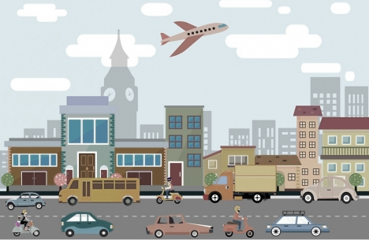
Activities in Time and Space
Well-being
Social inclusion
Time
Opportunity
Developments
Carbon emission
Mobility
Motorized transport modes
Congestion
95,000,000 motorized transport automobiles manufactured per year
y
Road accidents
73.7 %
are car
W
H
L
Urban sprawl
S
Activities:
H … Home W … Work L … Leisure S … Shopping
x

Slide 58
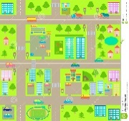


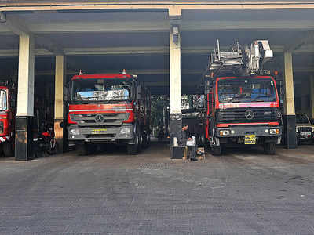
So what are we trying to solve?
Activities:
H … Home W … Work L … hospital S … Shopping
1. If we connect two neighborhoods, say using a transit, how will your activity change?
- Karan B
2. If we connect two cities and there are brown and green field station, how will they expand?
AI / ML techniques - Omkar K
10. Can activities be optimized to minimize energy use? - Vidhulekha T
Time
3. If we demolish a neighborhood and build something (good/bad???)
How will the activity and energy use change
- Dr. Sushibala N D
9. Public Health Policy assessment – Trupti
Insurance barriers – Nikita
Barriers to avail services – Availability, affordability and accessibility – Dr. Naveen K A
5. Assessment of parks and optimizing the expenditure to meet people’s needs - Dr. Divya S
y
4. Where should the emergency infra be located?:; Relationship with built form?
AI / ML techniques
- Dr. Vaibhav K U
6. Value of travel time – Dr. Varun V
7. Mode choice behavior & public transportation provisioning – Neenu T
Behavioral and Econometric Modelling
W
H
L
8. Assessment of networks in terms of photographs and sound
- Dr. Deepank V
11. Looking for someone – develop methodology to develop soundscape of Indian Cities?
- Anyone Interested??
S
x
If I have missed someone’s name, it is unintentional, I still improving these slides!!!

Slide 59
All the best!

Slide 60
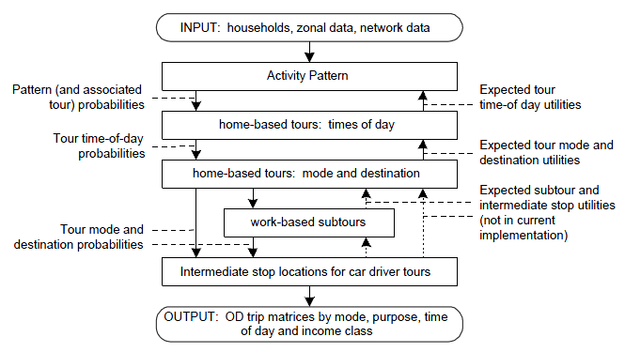
Portland Activity Schedule Model System

Slide 61
CONCLUSION
Conventional four stage-planning models for travel demand forecasting includes the lack of behavioral foundation, over dependence on trips, and insensitivity to policy changes.
There is a need to develop the models which will take into account above criteria's to improve the travel demand.
The new modeling approach i.e. activity based travel demand modeling has good scope in developing countries due to its more focus on behavioral aspect of people.

